Slide 1




Novembre 2023
Cancer de la prostate métastatique
Pour ou contre le triplet pour tous les patients ?
Avec le soutien institutionnel du laboratoire
Pr Karim FIZAZI
Dr Géraldine PIGNOT
Gustave Roussy Cancer Campus
Villejuif
Universite Paris Sarclay
Institut Paoli Calmettes
Marseille

Slide 2
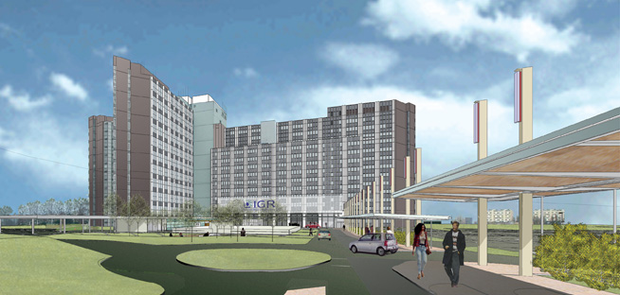

Novembre 2023
Cancer de la prostate métastatique
Pour ou contre le triplet pour tous les patients ?
Avec le soutien institutionnel du laboratoire
Treatment intensification in M1 Prostate Cancer
Pr Karim FIZAZI
Gustave Roussy Cancer Campus
Villejuif

Slide 3
Liens d’intérêts
Karim FIZAZI
Participation to advisory boards and talks for:
  Amgen, Astellas, Astrazeneca, Bayer, Clovis, Daiichi Sankyo, Janssen, MSD, Novartis/AAA, Pfizer, Sanofi
Honoraria go to Gustave Roussy, my institution.
Participation to advisory boards with personal honorarium for
Arvinas, CureVac, Macrogenics and Orion.
Novembre 2023

Slide 4
Who Dies of Prostate Cancer?
Upfront
localized cancer
44% of deaths
Metastases
Death
De novo
metastases
56% of deaths
Patrikidou A. Prostate Cancer Prostatic Dis. 2014;17:348-352.
Novembre 2023

Slide 5
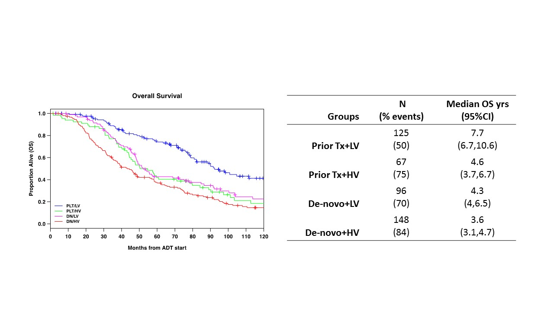
The outlier: M1 relapse and oligo
Overall Survival
Proportion alive (OS)
Distant Recurrence (%)
■ PLT/LV
■ PLT/HV
■ DN/LV
■ DN/HV
Months from ADT start
Gravis G, Eur Urol 2018 ; Francini E, Prostate 2018
Novembre 2023

Slide 6
Docetaxel effect in mCSPC: Timing of metastases is more important than « Volume »
Subgroup | Progression free survival |  |  | Overall survival
 | Number of events/ patients | % difference (95% CI) | Change from baseline | Number of events/ patients | % difference (95% CI) | Change from baseline
Disease volume x timing of diagnosis
Low volume, metachronous | 107/229 | -1% (-15 to 12%) | 48% to 47% | 70/229 | 0% (-10 to 12%) | 72% to 72%
Low volume, synchronous | 346/582 | 8% (1 to 15%) | 37% to 45% | 267/582 | 8% (0 to 16%) | 52% to 60%
High volume, metachronous | 92/132 | 11% (-2 to 24%) | 14% to 25% | 78/132 | 10% (-1 to 26%) | 28% to 38%
High volume, synchronous | 856/1044 | 12% (7 to 16%) | 11% to 23% | 736/1044 | 12% (7 to 18%) | 26% to 39%
Disease volume x clinical T stage
Low volume, cT-stage 1-3 | 302/569 | 5% (-2 to 12%) | 41% to 46% | 225/569 | 4% (-3 to 11%) | 58% to 62%
Low volume, cT-stage 4 | 61/85 | 12% (-6 to 29%) | 24% to 36% | 51/85 | 16% (-3 to 36%) | 38% to 54%
High volume, cT-stage 1-3 | 562/709 | 8% (4 to 13%) | 14% to 22% | 484/709 | 6% (0 to 12%) | 29% to 35%
High volume, cT-stage 4 | 157/192 | 27% (17 to 37%) | 8% to 35% | 136/192 | 35% (24 to 47%) | 20% to 55%
Vale C et al. ASCO®2022 (Abs.#5070)
Novembre 2023

Slide 7
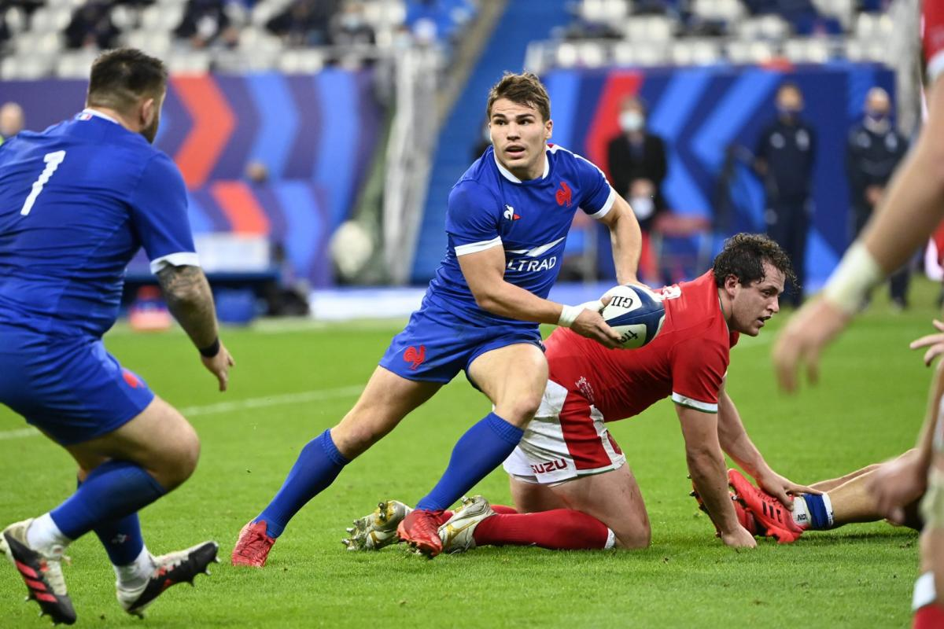
Should we intensify even more systemic treatment for men with mCSPC?
Taxanes and Second generation AR pathway inhibitors playing together?
Novembre 2023

Slide 8
Good reasons to use a systemic Triplet in fit men with mCSPC
Reason 1: It works!
Novembre 2023

Slide 9
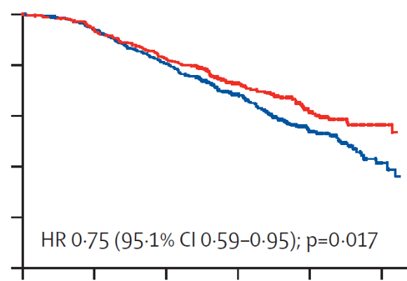
PEACE-1: ADT+docetaxel+Abiraterone > ADT+Docetaxel
ADT with docetaxel population
ADT with docetaxel population
Median rPFS = 2.03 vs 4.46 y
Median OS = 4.43 y vs NR
Radiographic PFS (%)
Overall survival (%)
HR, 0,50 (99,9%IC 0,34-0,71) ; p < 0,0001
HR, 0,75 (95,1%IC 0,59-0,951) ; p = 0,017
SOC without abiraterone | 355 | 329 | 281 | 172 | 78 | 18
SOC plus abiraterone | 355 | 328 | 287 | 183 | 98 | 25
Number at risk
Number at risk
SOC without abiraterone | 355 | 374 | 137 | 61 | 16 | 0
SOC plus abiraterone | 355 | 303 | 200 | 105 | 35 | 0
Fizazi K. , Lancet 2022
Novembre 2023

Slide 10
Triplet PEACE-1 OS results in the context
of recent data
Median Overall Survival (de novo High-Volume mCSPC)
ADT alone
33 m CHAARTED (Kyriakopoulos CE, JCO 2018)
34 m GETUG-15 (Gravis G Eur Urol 2018)
35 m STAMPEDE (Clarke NW, Ann Oncol 2019)
40 m STAMPEDE doce (Clarke Ann Oncol 2019)
42 m PEACE-1
44 m GETUG-15 (Gravis G Eur Urol 2018)
48 m CHAARTED (Kyriakopoulos CE, JCO 2018)
ADT+docetaxel
ADT+abiraterone
53 m LATITUDE (Fizazi K Lancet Oncol 2019)
53 m? STAMPEDE Abi (James N ESMO 2020)
ADT+docetaxel+abiraterone
61 m PEACE-1
Karim Fizazi
Novembre 2023

Slide 11

PEACE-1: Grade 3-5 Toxicity on study treatments
(ADT+docetaxel safety population)
Toxicity, n (%) | SOC (+/- RXT) + Abiraterone (n=346) | SOC (+/- RXT) (n=350)
Neutropenia | 34 (10) | 32 (9)
Febrile neutropenia | 18 (5) | 19 (5)
Liver | 20 (6) | 2 (1)
Hypertension | 76 (22) | 45 (13)
Hypokalemia | 11 (3) | 1 (0)
Cardiac | 6 (2) | 5 (1)
Fatigue | 10 (3) | 15 (4)
Gastro-intestinal | 14 (4) | 18 (5)
Grade 5 | 7 (2) | 3 (1)
Fizazi K, Lancet 2022
Novembre 2023

Slide 12
Good reasons to use a systemic Triplet in fit men with mCSPC
Reason 1: It works!
Reason 2: This is not a false positive
Novembre 2023

Slide 13
PEACE-1: Treatments beyond progression
(ADT+docetaxel population)
At least one treatment, n (%) | SOC (+/- RXT) + Abiraterone n_{CRPC} =141 | SOC (+/- RXT) n_{CRPC} =263
Life-prolonging treatment | 104 (74) | 221 (84)
Next gen. Hormonal Therapy | 65 (46) | 213 (81)
Abiraterone | 22 (16) | 153 (58)
Enzalutamide | 57 (40) | 119 (45)
Docetaxel | 29 (21) | 25 (10)
Cabazitaxel | 84 (60) | 114 (43)
Radium 223 | 3 (2) | 11 (4)
Lu-PSMA | 2 (1) | 3 (1)
Fizazi K, Lancet 2022
Novembre 2023

Slide 14
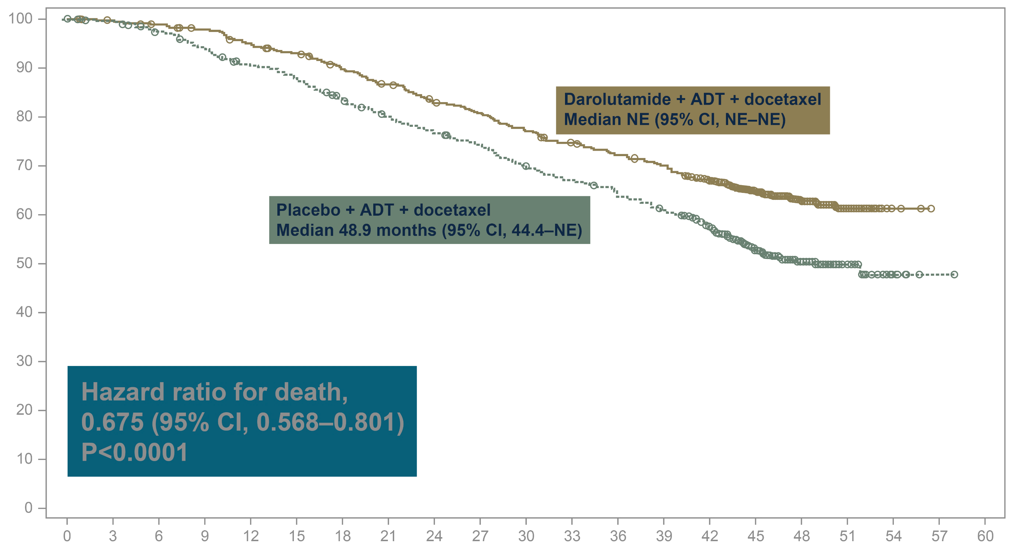
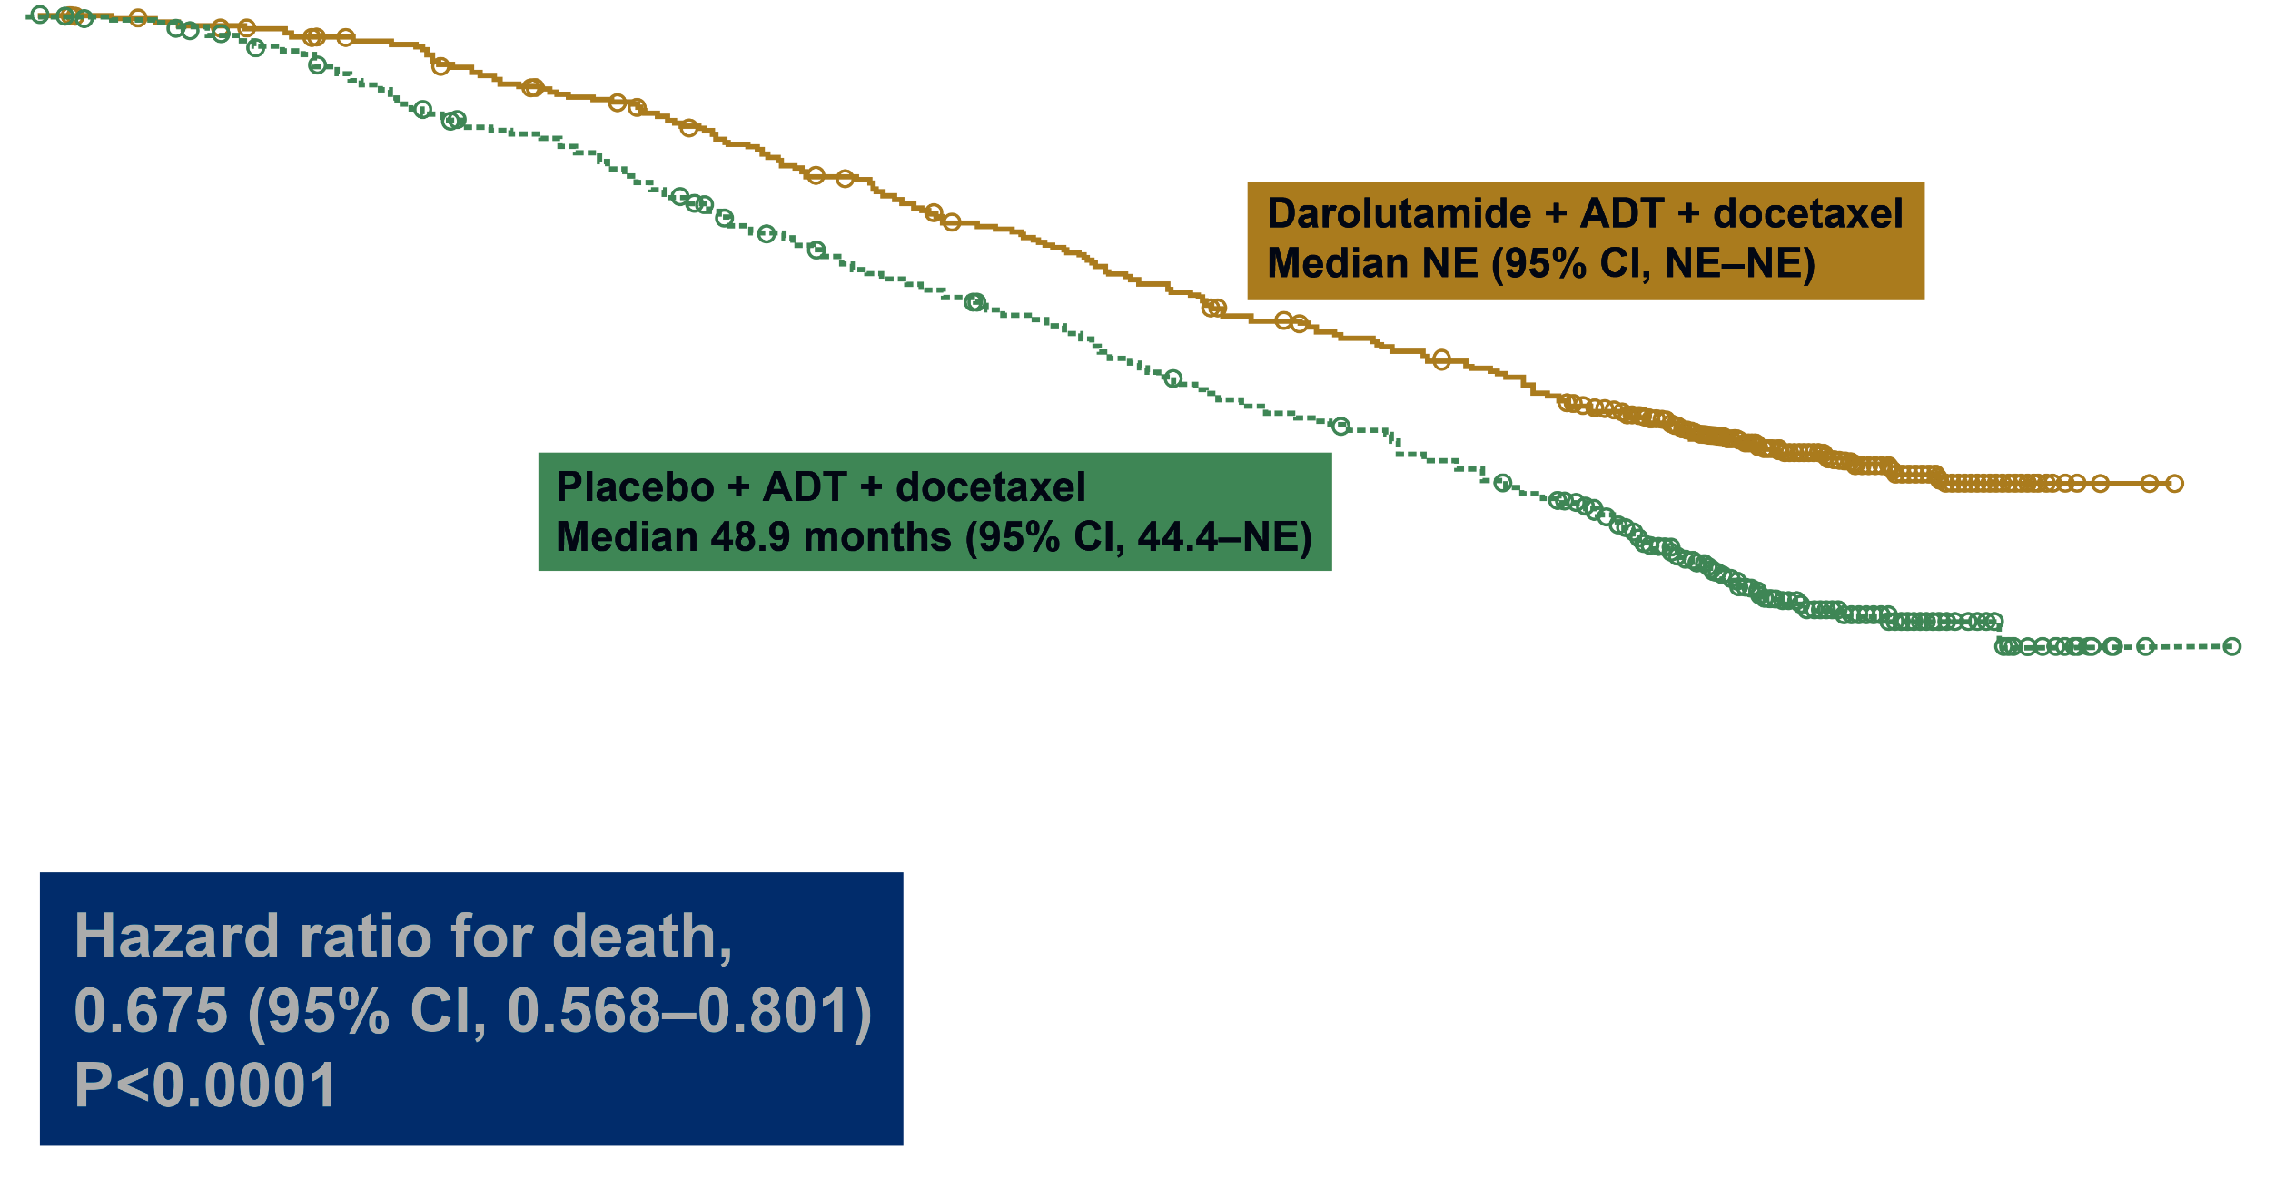
ARASENS Primary Endpoint*: Overall Survival
Darolutamide significantly reduced the risk of death by 32.5%
Darolutamide + ADT + docetaxel
Median NE (95%IC,NE-NE)
Darolutamide + ADT + docetaxel
Median NE (95%IC,NE-NE)
Placebo + ADT + docetaxel
Median 48,9 mois (95%IC,44,4-NE)
Placebo + ADT + docetaxel
Median 48,9 mois (95%IC,44,4-NE)
Patents who survivved (%)
HR, for death
0,675 (95%IC 0,568-0,801)
p < 0,0001
HR, for death
0,675 (95%IC 0,568-0,801)
p < 0,0001
Months since randomization
Nb à risque
651 | 645 | 637 | 627 | 608 | 593 | 570 | 548 | 525 | 509 | 486 | 468 | 452 | 436 | 402 | 267 | 139 | 56 | 9 | 0 | 0
654 | 646 | 630 | 607 | 580 | 565 | 535 | 510 | 488 | 470 | 441 | 424 | 402 | 383 | 340 | 218 | 107 | 37 | 6 | 1 | 0
*Primary analysis occurred after 533 deaths (darolutamide, 229; placebo, 304). CI, confidence interval; NE, not estimable.
Matthew R. Smith, Md, PhD
Novembre 2023
Notes:
Median follow-up for OS: darolutamide 43.7 mo; placebo 42.4 mo
Sources:
17777_ph42024_section_14.2 p7A,B,C, p8A, p9A
17777_ph42024_section_14.1 p190A

Slide 15
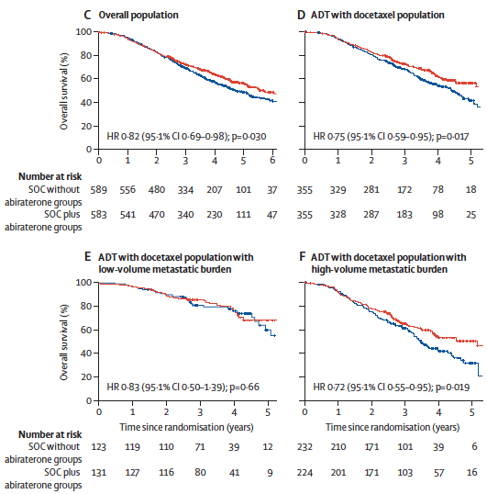
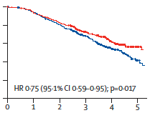
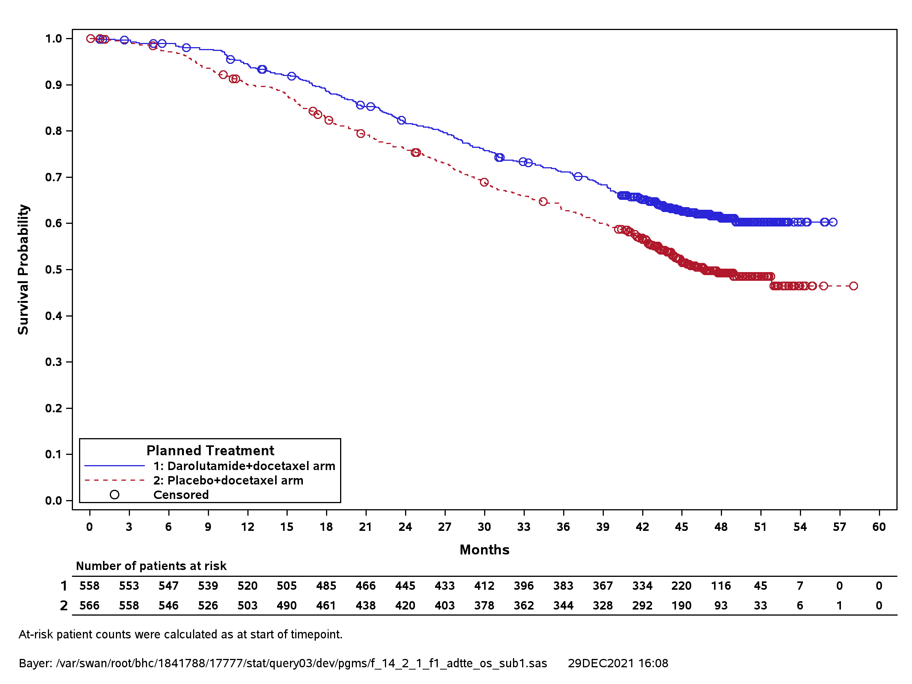
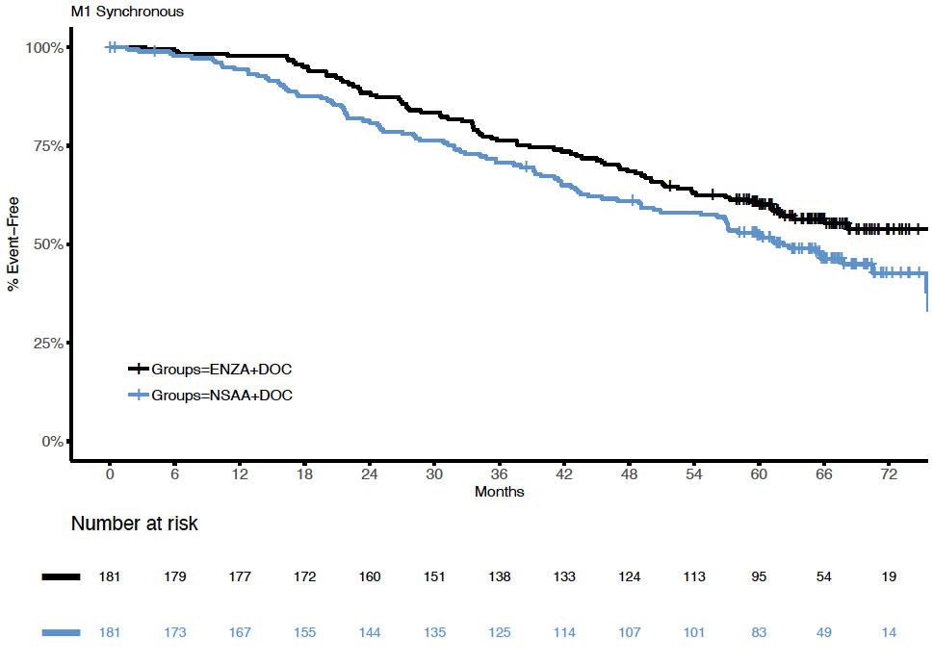
Consistent OS benefit with Triplet treatment
in men with de novo mCSPC
ADT + Doc + Abi > ADT + Doc
PEACE-1 (All De novo)
ADT + Doc + Daro > ADT + Doc
ARASENS (All De novo)
ADT + Doc + Enza > ADT + Doc
ENZAMET
Overall survival (%)
HR: 0.71
(95% CI: 0.59-0.85)
HR: 0.73
(95% CI: 0.595-0.99)
HR, 0,75 (95,1%IC 0,59-0,951)
p = 0,017
SOC without abiraterone | 355 | 329 | 281 | 172 | 78 | 18
SOC plus abiraterone | 355 | 328 | 287 | 183 | 98 | 25
Fizazi K Lancet 2022 ; Smith M NEJM 2022 ; Davis I ASCO® 2022
Novembre 2023

Slide 16
Good reasons to use a systemic Triplet in fit men with mCSPC
Reason 1: It works!
Reason 2: This is not a false positive
Reason 3: The control arm was just standard treatment when phase 3 trials were designed and conducted
Novembre 2023

Slide 17
Good reasons to use a systemic Triplet in fit men with mCSPC
Reason 1: It works!
Reason 2: This is not a false positive
Reason 3: The control arm was just standard treatment when phase 3 trials were designed and conducted
Reason 4: No available comparative data for triplet vs bi-hormonal therapy but benefit is likely
Novembre 2023

Slide 18
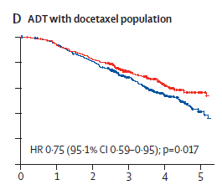

Systemic triplet likely better than hormonal doublets
Some maths:
If ADT-ARSI = ADT-Doce (Small E, ASCO 2017)
And Triplet > ADT-Doce (PEACE-1, ARASENS, ENZAMET)
Then Triplet > ADT-ARSI
Docetaxel
Abiraterone
ADT Alone (CHAARTED)
ADT Alone (LATITUDE)
ADT with docetaxel population
HR, 0,75 (95,1%IC 0,59-0,951) ; p = 0,017
355 | 329 | 281 | 172 | 78 | 18
355 | 328 | 287 | 183 | 98 | 25
Novembre 2023

Slide 19
Good reasons to use a systemic Triplet in fit men with mCSPC
Reason 1: It works!
Reason 2: This is not a false positive
Reason 3: The control arm was just standard treatment when phase 3 trials were designed and conducted
Reason 4: No available comparative data for triplet vs bi-hormonal therapy but benefit is likely
Reason 5: The biological rationale is strong
Novembre 2023

Slide 20
Systemic Triplet: A robust rationale
Both ARPI and Taxanes active after one has failed:
COU 301/AFFIRM (ARPI post-taxane)
CARD (Taxane post-ARPI)
Poly-therapy needed to target heterogeneity (some cells are resistant
to AR targeting, some others are resistant to taxane)
Until we have a biomarker to tease out AR/taxane sensitivity, combination is required!
Novembre 2023

Slide 21
Good reasons to use a systemic Triplet in fit men with mCSPC
Reason 1: It works!
Reason 2: This is not a false positive
Reason 3: The control arm was just standard treatment when phase 3 trials were designed and conducted
Reason 4: No available comparative data for triplet vs bi-hormonal therapy but benefit is likely
Reason 5: The biological rationale is strong
Reason 6: Efficacy/safety balance
Novembre 2023

Slide 22
Triplet: A better Efficacy/Safety ratio compared
to sequential use
If an ADT-ARPI doublet is used for mCSPC, then docetaxel will be used anyway when mCRPC occurs!
Why not use it earlier (mCSPC) with more efficacy and less toxicity?
6 cycles of docetaxel is short and mostly well tolerated with G-CSF support
(cf PEACE-1 safety data)
Novembre 2023

Slide 23
Good reasons to use a systemic Triplet in fit men with mCSPC
Reason 1: It works!
Reason 2: This is not a false positive
Reason 3: The control arm was just standard treatment when phase 3 trials were designed and conducted
Reason 4: No available comparative data for triplet vs bi-hormonal therapy but benefit is likely
Reason 5: The biological rationale is strong
Reason 6: Efficacy/safety balance
Novembre 2023

Slide 24
Novembre 2023
Cancer de la prostate métastatique
Pour ou contre le triplet pour tous les patients ?
Avec le soutien institutionnel du laboratoire
Contre le triplet pour tous
Dr Géraldine PIGNOT
Institut Paoli Calmettes
Marseille

Slide 25
Liens d’intérêts
Géraldine PIGNOT
  Invitation(s) congrès et présentations :
  Janssen, Ipsen, MSD, Bouchara Recordati, BMS, AAA, Bayer, Pfizer
  Table(s) ronde(s) scientifique(s) :
  Astra-Zeneca, Merck, Bayer, Pfizer, BMS, Janssen, Astellas
  Ecriture d’article(s) scientifique(s)
  LeCancer.fr, Kephren, Correspondances en Onco-Urologie
Novembre 2023

Slide 26

Deux manières d’intensifier le traitement au stade CPHSm
  Intensification du traitement systémique :
    Chimiothérapie
    NHT
  Intensification par traitement local :
    Au niveau de la prostate : radiothérapie prostatique
    Au niveau des sites métastatiques : traitement focal
Pour tous les patients ?
Novembre 2023

Slide 27













L’utopie « Pour tous » ?
Novembre 2023

Slide 28
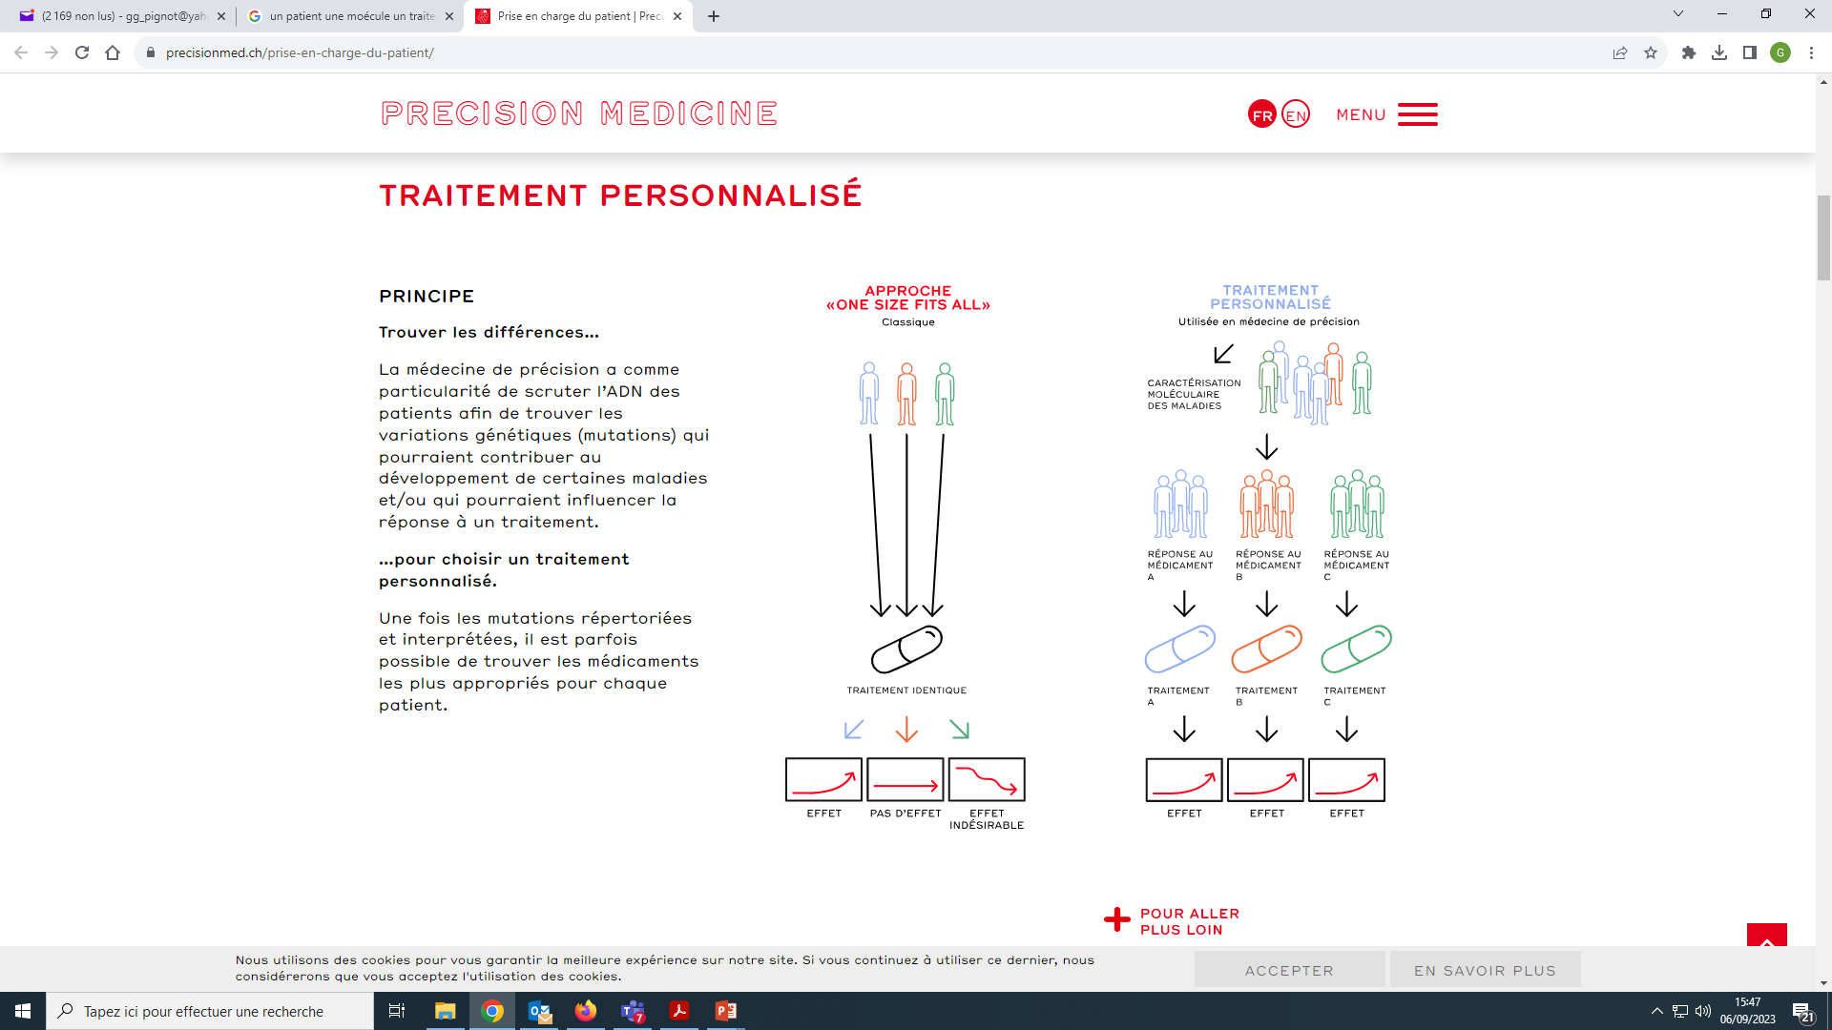
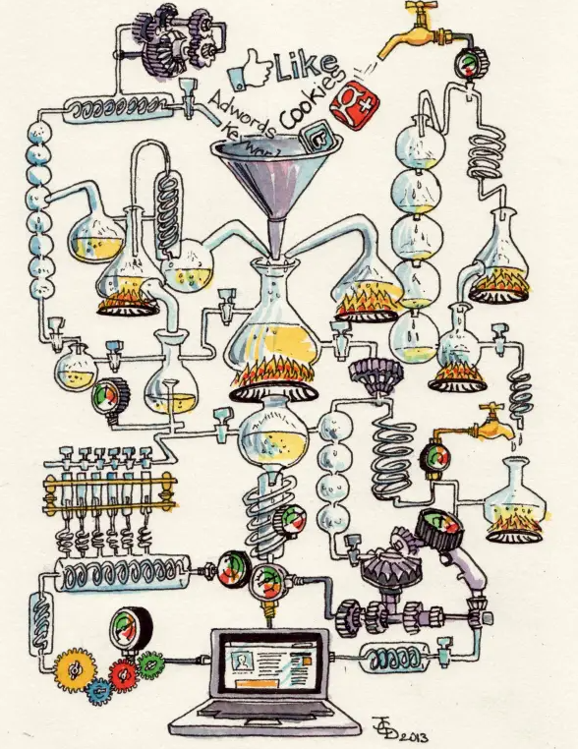
Approche « all comers » vs la vraie vie
Novembre 2023

Slide 29
Intensification « all comers » avec NHT ?
CPHSm | Nouvelles hormonothérapies |  |  |  | Chimiothérapie
 | Acétate d’abiratérone | Enzalutamide | Enzalutamide | Apalutamide | Docétaxel
Etude pivotale | LATITUDE | ARCHES | ENZAMET | TITAN | CHAARTED
Population | M1 100% haut risque 100% de novo | M1 62% haut volume 70% de novo | M1 52% haut volume 58% de novo | M1 63% haut volume 83% de novo | M1 (haut volume) 73% de novo
Traitement associé | HT | HT ± Docétaxel (18%) | HT ± Docétaxel (44%) | HT ± Docétaxel (11%) | HT
Bénéfice | Survie globale | rPFS | Survie globale | Survie globale | Survie globale
AMM | OUI | OUI | OUI | OUI | OUI
Remboursement | OUI | NON | NON | OUI | OUI
Recommandé (Reco CCAFU 2020) | Oui De novo haut risque | OUI | OUI | OUI | OUI De novo haut volume
Novembre 2023

Slide 30
Intensification « all comers » avec NHT ?
 | CHAARTED | STAMPEDE DOCE | LATITUDE | STAMPEDE ABI | ARCHES | ENZAMET | TITAN | PEACE 1 | ARASENS
Phase | Phase III | Phase III | Phase III | Phase III | Phase III | Phase III | Phase III | Phase III | Phase III
Effectif | N=790 | N=1776 | N=1199 | N=1917 | N=1150 | N=1125 | N=1052 | N=1173* | N=1306
Traitement | DOC vs PBO | DOC vs PBO | ABI vs PBO | ABI vs PBO | ENZ vs PBO | ENZ vs AANS | APA vs PBO | [ADT vs ABI ou [DOC vs DOC + ABI] | DOC + PBO vs DOC + DARO
Critère principal | Survie globale | Survie globale | Survie globale SSPr | Survie globale | SSPr | Survie globale | Survie globale SSPr | Survie globale | Survie globale
De novo Métachrone | 73% 27% | 95% 5% | 100% 0% | 95% 5% | 70% 30% | 58% 42% | 83% 17% | 100% 0% | 86% 14%
Haut volume Bas volume | 65% 35% | ? | 100% 0% | 56% 44% | 62% 38% | 52% 48% | 63% 37% | 64% 37% | 77% 23%
Docetaxel associé | NA | NA | Non | Non | Optionnel avant (18%) | Optionnel pendant (45%) | Optionnel avant (11%) | 100% | 100%
Suivi médian | 54 mois | 78 mois | 52 mois | 73 mois | 45 mois | 34 mois | 44 mois | 53 mois | 44 mois
Novembre 2023

Slide 31
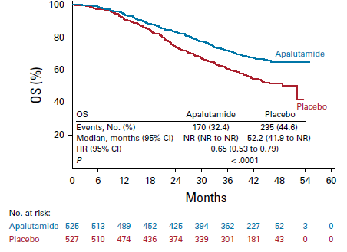
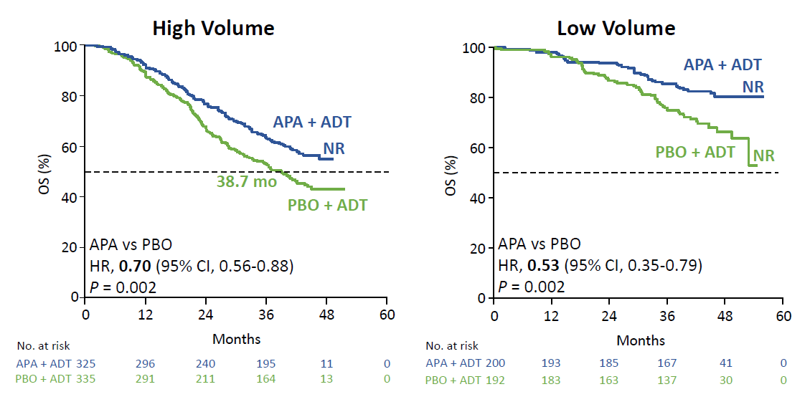
Intensification « all comers » avec APA
Apalutamide + ADT : étude TITAN
HR=0.65 IC95% [0.53-0.79]; p < 0,0001
 | Events/No. |  | Median OS (months)
Subgroup | Apalutamide | Placebo | Apalutamide | Placebo |  | HR (95% CI)
All patients | 170/525 | 235/527 | NR | 52.2 |  | 0.85 (0.53 to 0.79)
High volume | 134/325 | 175/335 | NR | 38.7 |  | 0.70 (0.58 to 0.85)
Low volume | 38/200 | 60/192 | NR | NR |  | 0.52 (0.35 to 0.79)
Low volume
HR : 0,52 (0,35-0,79)
Favours apalutamide
0.1
1.0
10.0
Favours placebo
Chi KN, et al. J Clin Oncol. 2021 Apr 29
Chi KN, et al. N Engl J Med 2019;381:13-24
Novembre 2023
Notes:
Bénéfice majeur en survie globale du doublet ADT + HTNG chez « bas volume »

Slide 32
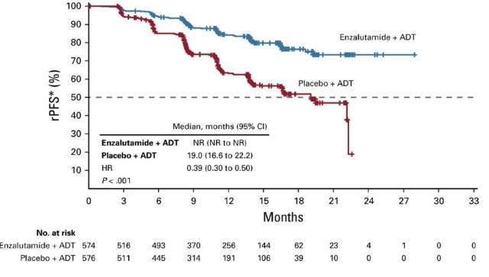
Intensification « all comers » avec ENZA
Enzalutamide + ADT : études ARCHES et ENZAMET
ARCHES
ENZAMET
Subgroup | ENZA+AOT No. (E) | PBO+ADT No. (E) | Median (ENZA/PBO, months) |  | HR (95% CI)
All subgroups | 574 (154) | 576 (202) | NR/NR |  | 0.66 (0.53 to 0.51)
Low volume of disease | 220 (35) | 203 (46) | NR/NR |  | 0.66 (0.43 to 1.03)
High volume of disease | 354 (119) | 373 (156) | NR/45.9 |  | 066 (0.52 to 0.83)
Low volume
ARCHES
HR : 0,66
(0,43-1,03)
ENZAMET
HR : 0,54
(0,39-0,74)
Charateristics | Level | CTRL n/N | ENZA n/N |  | HR (95% CI) | P-value interaction | Adj P-value interaction
Overall | All patients | 268/562 | 208/583 |  | 0.70 (0.58 to 0.84)
Early Docciaxel planned | Yes No | 123/250 145/312 | 108/253 100/310 |  | 0.82 (0.63 to 1.06) 0.60 (0.47 to 0.78) | 0.09 | 0.47
Volume of disease | Low High | 97/261 171/301 | 59/282 148/301 |  | 0.54 (0.39 to 0.74) 0.79 (0.63 to 0.98) | 0.06 | 0.47
Favours ENZA+ADT
0.0
1.0
2.0
Favours PBO+ADT
0.25
0.50
1.0
2.0
4.0
Davis ID. N Engl J Med 2019;381(2):121-131
Armstrong AJ. J Clin Oncol 2019;372974-2986
Novembre 2023

Slide 33
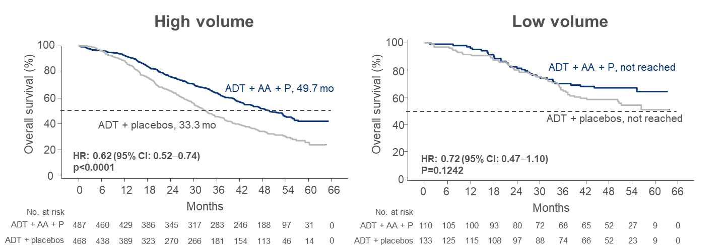
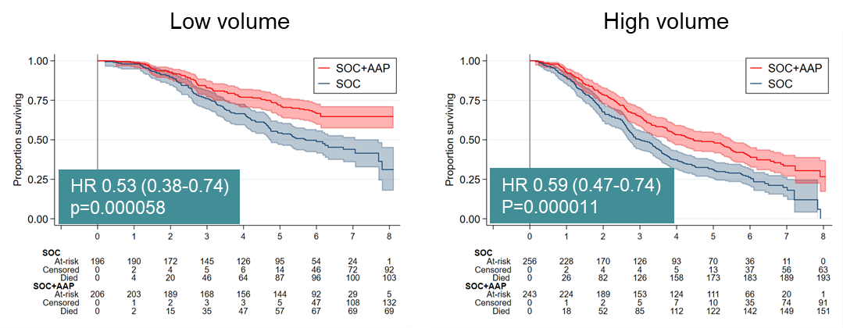
Intensification « all comers » avec ABI
Abiratérone + ADT : étude STAMPEDE (et LATITUDE)
LATITUDE
100% patients mHSPC De Novo
80% Haut Volume
STAMPEDE
100% patients mHSPC De Novo
55% Haut Volume
Overall | OS (HR) | p value
LATITUDE | 0.66 (0.56; 0.78) | <0,0001
Overall | OS (HR) | p value
STAMPEDE M1 cohort | 0.60 (0.50; 0.71) | 0,00000000003
  Suivi médian de 51,8 mois
  Suivi médian de 73,2 mois
Fizazi K, et al. Lancet Oncol. 2019 May;20(5):686-700.
James N. presidential session ESMO® 2020
Novembre 2023

Slide 34
Intensification « all comers » avec NHT
Patients CPHSm « all comers »
De novo (synchrone) ou métachrone
Haut volume/haut risque ou bas volume/bas risque
NHT par apalutamide ou enzalutamide
Recommandations | Grade
Une intensification du traitement systématique par l’ajout d’une HTNG est recommandée chez tout patient M1 (SAd + HTNG) | Fort
Il n’y a plus d’indication à intensifier la suppression androgénique par le docétaxel seul (Sad + docetaxel), sans association avec une HTNG | Fort
La combinaison SAd + HTNG + docétaxel (triplet) est recommandée pour des patients éligibles à la chimiothérapie, préférentiellement en cas de maladie M1 de novo et à haut volume. L’HTNG sera alors soit l’abiratérone, soit le darolutamide (ordre alphabétique) | Fort
Ploussard et al. Reco CCAFU 2022
Novembre 2023

Slide 35
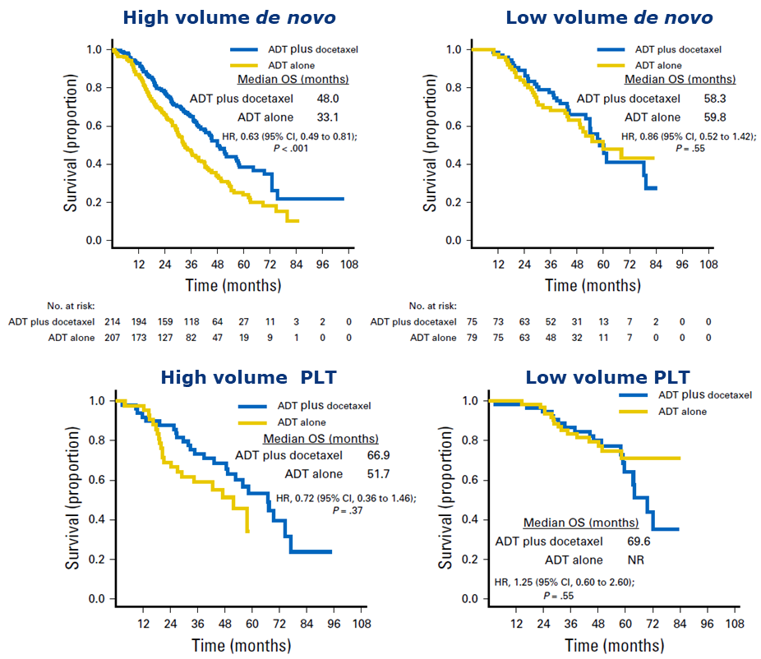
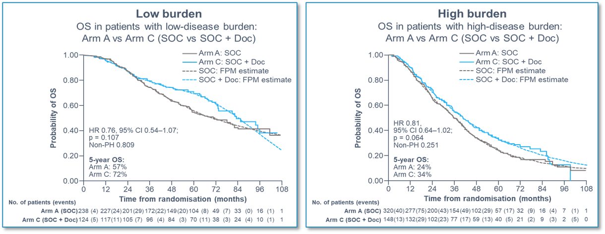
CPHSm – DOCETAXEL
Bénéfice en survie globale pour les hauts volumes
CHAARTED
STAMPEDE – Arm C –
Doce + ADT vs ADT
73% De Novo
65 % Haut Volume
100% De Novo
56 % Haut Volume
HR 0.63 (0.49-0.81)
P<0,001
HR 0.86 (0.52-1.42)
P=0.55
HR 1.25 (0.60-2.60)
P=0.55
HR 0.72 (0.36-1.46)
P=0.37
HR 0.76 (0.54-1.07)
P=0.107
HR 0.81 (0.64-1.02)
P=0.064
Sweeney C J et al. N Engl J Med 2015;373(8):737–46;
Kyriakopoulos CE, et al. J Clin Oncol 2018;36(11):1080-87
Clarke NW, et al. ESMO 2019. Oral presentation 844O;
Clarke NW. Ann Oncol 2019;0: 1–12
Novembre 2023

Slide 36
Intérêt d’associer NHT + chimio ?
PEACE-1 : essai de phase III (double randomisation)
A phase 3 trial with a 2x2 factorial design in de novo mHSPC
Critères d’éligibilités clés
CPHSm De novo
Maladie métastatique à distance avec ≥ 1
lésion sur Scinti os et/ou TDM
ECOG PS 0-2
Nécessaire durant l’étude
Poursuite ADT
Stratification
ECOG PS (0 vs. 1-2)
Sites Métastatiques (ganglions vs. os vs. viscéral)
Type de castration
(orchidectomie vs. agoniste LHRH vs. antagoniste LHRH)
Docétaxel (oui vs. non)
Nov 2013 –
Dec 2018
SOC
(n=296)
SOC + Abiraterone
(n=292)
R
1:1:1:1
SOC + Radiothérapie
(n=293)
N=1173
SOC + Abiraterone + Radiothérapie
(n=292)
Fizazi K. et al. Lancet 2022;399:1695
Novembre 2023

Slide 37
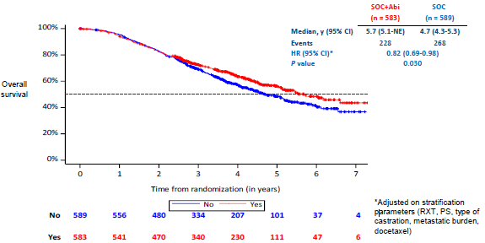
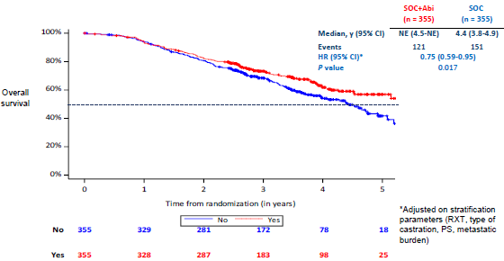
Intérêt d’associer NHT + chimio ?
PEACE-1 : survie globale
OS in the Overall population
OS with Abiraterone in the ADT + docetaxel (+/-RXT) population
Fizazi K. et al, Lancet 2022;399:1695
Novembre 2023

Slide 38
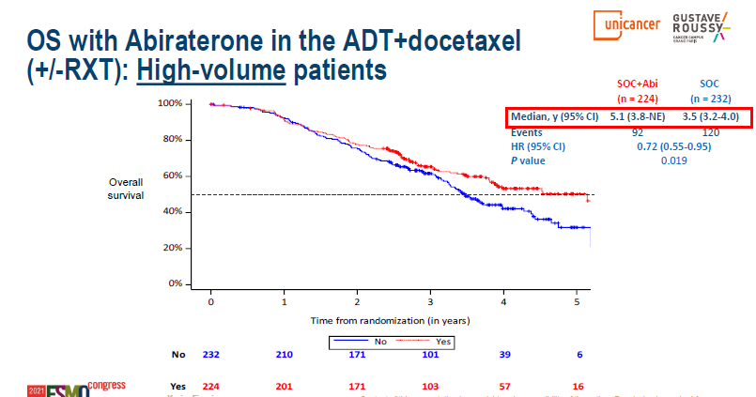
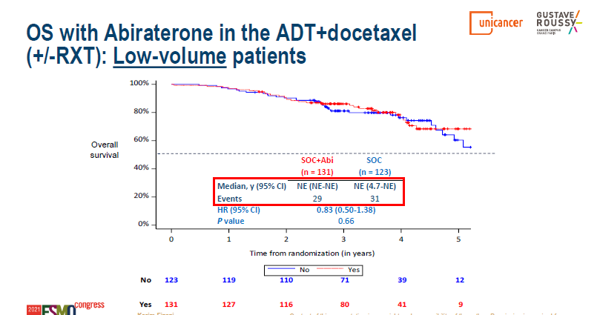
PEACE-1 : SG selon le volume métastatique
Bénéfice en SG pour les patients « haut volume »
Bénéfice absolu de 1.6 ans
Trop peu d’événement pour conclure
Bras contrôle non recommandé pour les « bas volume »
Low volume HR : 0,83 (0,50-1,38)
Fizazi K. et. al, Lancet 2022;399:1695
Novembre 2023

Slide 39
Intérêt d’associer NHT + chimio ?
ARASENS Study Design, Global, randomized, double-blind, placebo-controlled phase III study (NCT02799602)
Docetaxel x 6
Primary endpoints
OS
Secondary endpoints
Time to CRPC
Time to pain progression
SSE-free survival
Time to first SSE
Time to initiation of subsequent systemic antineoplastic therapy
Time to worsening of disease-related physical symptoms
Time to initiation of opioid use for ≥ 7 consecutive days
Safety
Patients (N=1306)
mHSPC
ECOG PS 0 or 1
Candidates for ADT and docetaxel
Stratification
Extent of disease: M1a vs M1b vs M1c
ALP < vs ≥ ULN
Darolutamide 600 mg
twice daily + ADT
R
1:1
Primary analysis
N=1305*
Placebo twice daily + ADT
FPFV: Nov 2016
LPFV: June 2018
Docetaxel x 6
Data cut-off
Oct 25, 2021
The primary analysis was planned to occur after ∼509 deaths
Secondary efficacy endpoints were tested hierarchically
Intérêt d’associer NHT + chimio ? ARASENS design
*One enrolled patient was excluded from all analysis sets because of Good Practice violations. ALP, alkaline phosphatase; CRPC, castration-resistant prostate cancer; ECOG PS, Eastern Cooperative Oncology Group performance status; FPFV, first patient first visit; LPFV, last patient first visit; M1a, nonregional lymph node metastases only; M1b, bone metastases ±lymph node metastases; M1c, visceral metastases ± lymph node or bone metastases: Q3W, every 3 weeks: SSE, symptomatic skeletal event; ULN, upper limit of normal.
Hussain et al. JCO 2023
Novembre 2023

Slide 40
ARASENS : Survie globale
ARASENS Primary Endpoint*: Overall Survival
Darolutamide significantly reduced the risk of death by 32.5%
62.7 %
Darolutamide + ADT + docetaxel
Median, NE (95% CI, NE-NE)
Placebo + ADT + docetaxel
Median, 48.9 months
(95% CI, 44.4-NE)
50.4 %
Hazard ratio for death, 0.68 (95% CI, 0.57-0.80) P<0.001
No at risk
RIB + NSAI | 651 | 645 | 637 | 627 | 608 | 593 | 570 | 548 | 525 | 509 | 486 | 468 | 452 | 436 | 402 | 267 | 139 | 56 | 9 | 0 | 0
NSAI seul | 654 | 646 | 630 | 607 | 580 | 565 | 535 | 510 | 488 | 470 | 441 | 424 | 402 | 383 | 340 | 218 | 107 | 37 | 6 | 1 | 0
Months since randomization
*Primary analysis occured after 533 deaths (darolutamide, 229: placebo, 304). CI, confidence interval; NE, not estimable.
Hussain et al. JCO 2023
Novembre 2023

Slide 41
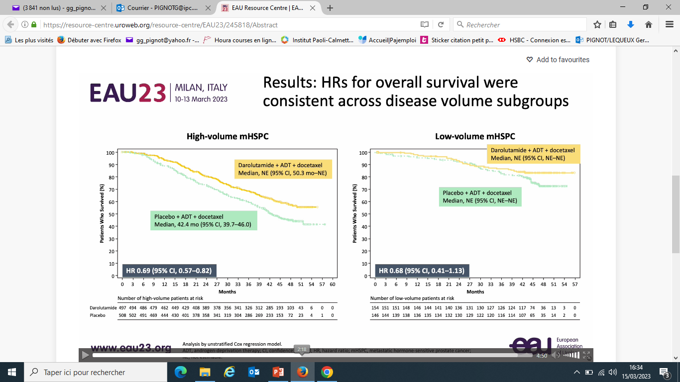
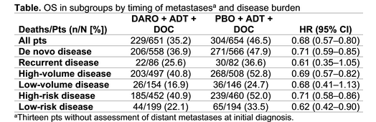
ARASENS : SG selon le volume métastatique
Hussain et al. JCO 2023
Novembre 2023

Slide 42
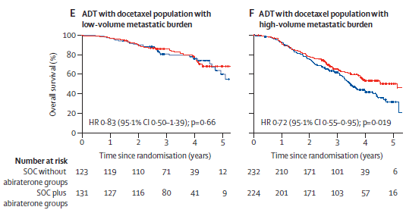
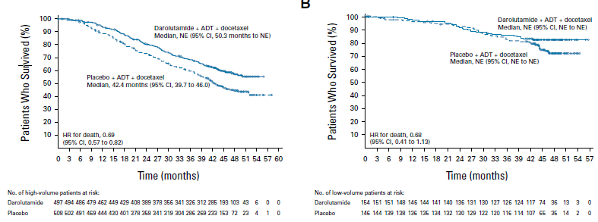
TRIPLET : Take home message
PEACE-1
ARASENS
Pas de bénéfice significatif en OS du triplet chez « bas volume »
Fizazi et al. Lancet 2022 ; Hussain et al. JCO 2023
Novembre 2023

Slide 43

Bas volume : quelle stratégie optimale en 2023 ?
HT + NHT
Bénéfice en OS
(TITAN, ENZAMET, ARCHES et STAMPEDE-Abi)
Vs HT
HT + Docetaxel
Pas de bénéfice en OS
(CHAARTED et STAMPEDE-Doce)
Vs HT
HT + docetaxel + NHT
Pas de bénéfice en OS
(PEACE-1 et ARASENS)
Vs HT + doce
Novembre 2023

Slide 44
ENZAMET : tolérance
Adverse events of interest in docetaxel stratum within 6 months of randomization
 | Anti-androgen |  |  |  |  |  |  |  |  |  |  |  | Enzalutamide
 | With Docetexel |  |  |  |  |  | Without Docetaxel |  |  |  |  |  | With Docetexel |  |  |  |  |  | Without Docetaxel
Worst Grade | 1 | 2 | 3 | 4 | 5 | N | 1 | 2 | 3 | 4 | 5 | N | 1 | 2 | 3 | 4 | 5 | N | 1 | 2 | 3 | 4 | 5 | N
Watering eyes | 13 | 2 | 0 | 0 | 0 | 15 | 0 | 0 | 0 | 0 | 0 | 0 | 48 | 4 | 0 | 0 | 0 | 52 | 1 | 0 | 0 | 0 | 0 | 1
Fatigue | 130 | 35 | 1 | 0 | 0 | 166 | 99 | 9 | 1 | 0 | 0 | 109 | 140 | 52 | 7 | 0 | 0 | 199 | 128 | 32 | 7 | 0 | 0 | 167
Neutrophil count decreased | 5 | 3 | 4 | 10 | 0 | 22 | 2 | 0 | 0 | 0 | 0 | 2 | 1 | 4 | 17 | 13 | 0 | 35 | 4 | 0 | 0 | 1 | 0 | 5
Dysesthesia | 1 | 0 | 0 | 0 | 0 | 1 | 0 | 0 | 0 | 0 | 0 | 0 | 0 | 0 | 0 | 0 | 0 | 0 | 1 | 0 | 0 | 0 | 0 | 1
Paresthesia | 5 | 1 | 0 | 0 | 0 | 6 | 6 | 0 | 0 | 0 | 0 | 6 | 13 | 1 | 0 | 0 | 0 | 14 | 9 | 0 | 0 | 0 | 0 | 9
Peripheral motor neuropathy | 1 | 1 | 0 | 0 | 0 | 2 | 0 | 0 | 0 | 0 | 0 | 0 | 9 | 4 | 0 | 0 | 0 | 13 | 0 | 0 | 1 | 0 | 0 | 1
Periphal sensory neuropathy | 62 | 7 | 1 | 0 | 0 | 70 | 10 | 2 | 0 | 0 | 0 | 12 | 77 | 24 | 3 | 0 | 0 | 104 | 10 | 0 | 0 | 0 | 0 | 10
Alopecia | 44 | 13 | 0 | 0 | 0 | 57 | 5 | 0 | 0 | 0 | 0 | 5 | 50 | 21 | 0 | 0 | 0 | 71 | 3 | 1 | 0 | 0 | 0 | 4
Nail discoloration | 13 | 0 | 0 | 0 | 0 | 13 | 13 | 0 | 0 | 0 | 0 | 0 | 25 | 0 | 0 | 0 | 0 | 25 | 0 | 0 | 0 | 0 | 0 | 0
Nail loss | 4 | 0 | 0 | 0 | 0 | 4 | 2 | 0 | 0 | 0 | 0 | 2 | 4 | 0 | 0 | 0 | 0 | 4 | 0 | 1 | 0 | 0 | 0 | 1
David ID. N Engl J Med 2019;381 (2) 121-131
Novembre 2023

Slide 45
PEACE-1 : tolérance
Grade 3-5 Toxicity on study treatments (ADT + docetaxek safety population)
Toxicity | SOC(+/- RXT) + Abiraterone (n=346) | SOC (+/- RXT) (n=350)
Neutropenia* | 34 (10) | 32 (9)
Fabrile neutropenia | 18 (5) | 19(5)
Liver | 20 (6) | 2 (1)
Hypertension | 76 (22) | 45 (13)
Hyperglycemia | 11 (3) | 1 (0)
Cardiac | 6 (2) | 5 (1)
Fatigue | 10 (3) | 15 (4)
Gastro intestinal | 14 (4) | 18 (5)
Grade 5 | 7 (2) | 3 (1)
Fizazi K. et. al, Lancet 2022;399:1695
Novembre 2023

Slide 46
ARASENS : tolérance
Effets secondaires Grade 3-4
Grade 3-4 AEs in >2% of darolutamide-treated patients, n (%) | Darolutamide + ADT + docetaxel (n=652) | Placebo + ADT + docetaxel (n=650)
Any AE | 431 (66.1) | 413 (63.5)
Neutropenia* | 220 (33.7) | 222 (34.2)
Fabrile neutropenia | 51 (7.8) | 48 (7.4)
Hypertension | 42 (6.4) | 21 (3.2)
Anemia | 31 (4.8) | 33 (5.1)
Pneumonia | 21 (3.2) | 20 (3.1)
Hyperglycemia | 18 (2.8) | 24 (3.7)
Increased alanine aminotransferase | 18 (2.8) | 11 (1.7)
Increased aspartate aminotransferase | 17 (2.6) | 7 (1.1)
Increased weight | 14 (2.1) | 8 (1.2)
Urinary tract infection | 13 (2.0) | 12 (1.8)
Hussain et al. JCO 2023
Novembre 2023

Slide 47
ARASENS : tolérance
Analyse en sous-groupes selon volume
Docetaxel-related TEAs*, n (%) | High volume |  |  |  | Low volume
 | DARO (n=498) | EAIR (100 PY) | Placebo (n=506) | EAIR (100 PY) | DARO (n=154) | EAIR (100 PY) | Placebo (n=144) | EAIR (100 PY)
Alopecia | 192 (38.6) | 15.3 | 202 (39.9) | 23.1 | 72 (46.8) | 15.2 | 62 (43.1) | 18.9
Neutropenia† | 170 (34.1) | NA† | 170 (33.6) | NA† | 50 (32.5) | NA† | 52 (36.1) | NA†
Fatigue | 166 (33.3) | 13.2 | 165 (32.6) | 18.9 | 50 (32.5) | 10.6 | 49 (34.0) | 15.0
Anemia | 140 (28.1) | 11.1 | 132 (26.1) | 15.1 | 41 (26.6) | 8.7 | 31 (21.5) | 9.5
Peripheral edema | 136 (27.3) | 10.8 | 138 (27.3) | 15.8 | 37 (24.0) | 7.8 | 31 (21.5) | 9.5
Diarrhea | 120 (24.1) | 9.5 | 114 (22.5) | 13.0 | 47 (30.5) | 9.9 | 42 (29.2) | 12.8
Constipation | 114 (22.9) | 9.1 | 106 (20.9) | 12.1 | 33 (21.4) | 7.0 | 24 (16.7) | 7.3
Pyrexia | 67 (13.5) | 5.3 | 66 (13.0) | 7.5 | 19 (12.3) | 4.0 | 24 (16.7) | 7.3
Cough | 56 (11.2) | 4.5 | 53 (10.5) | 6.1 | 28 (18.2) | 5.9 | 20 (13.9) | 6.1
Insomnia | 56 (11.2) | 4.5 | 60 (11.9) | 6.9 | 18 (11.7) | 3.8 | 21 (14.6) | 6.4
Stomatitis | 52 (10.4) | 4.1 | 46 (9.1) | 5.3 | 14 (9.1) | 3.0 | 11 (7.6) | 3.4
Peripheral neuropathy | 48 (9.6) | 3.8 | 48 (9.5) | 5.5 | 28 (18.2) | 5.9 | 19 (13.2) | 5.8
Peripheral sensory neuropathy | 52 (10.4) | 4.1 | 50 (9.9) | 5.7 | 13 (8.4) | 2.7 | 17 (11.8) | 5.2
EAU 2023 : A1183: Efficacy and safety of darolutamide (DARO) in combination with androgen-deprivation therapy (ADT) and docetaxel (DOC) in patients (pts) with metastatic hormone sensitive prostate cancer (mHSPC) by metastatic burden: Subgroup analyses of ARASENS
Novembre 2023

Slide 48
ARASENS : tolérance
The most common TEAEs leading to docetaxel dose reduction in the darolutamide and placebo groups were:
  Decreased neutrophil count (5.4%, 6.0%)
  Febrile neutropenia (3.7%, 3.8%)
  Decreased white blood cell count (3.2%, 3.4%)
  Neutropenia (1.8%, 2.2%)
(%)
Darolutamide + ADT + docetaxel
Placebo + ADT + docetaxel
19.9 %
19.5 %
8.0 %
10.3 %
Percentage of patients with TEAEs leading to docetaxel dose reduction
Percentage of patients with TEAEs leading to docetaxel discontinuation
EAU 2023 : A1183: Efficacy and safety of darolutamide (DARO) in combination with androgen-deprivation therapy (ADT) and docetaxel (DOC) in patients (pts) with metastatic hormone sensitive prostate cancer (mHSPC) by metastatic burden: Subgroup analyses of ARASENS
Novembre 2023

Slide 49
Triplet : Quels sont les patients qui en bénéficient ?
PEACE-1
ARASENS
Haut volume
Novembre 2023

Slide 50
Triplet : Quels sont les patients qui n’en bénéficient pas ?
PEACE-1
ARASENS
Bas volume
Novembre 2023

Slide 51
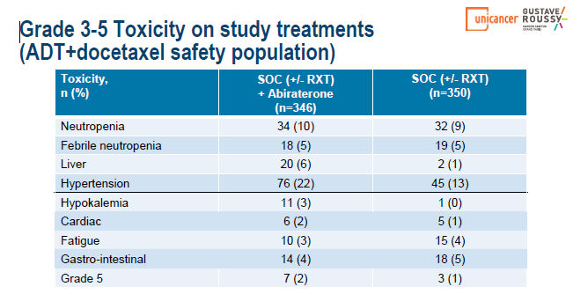
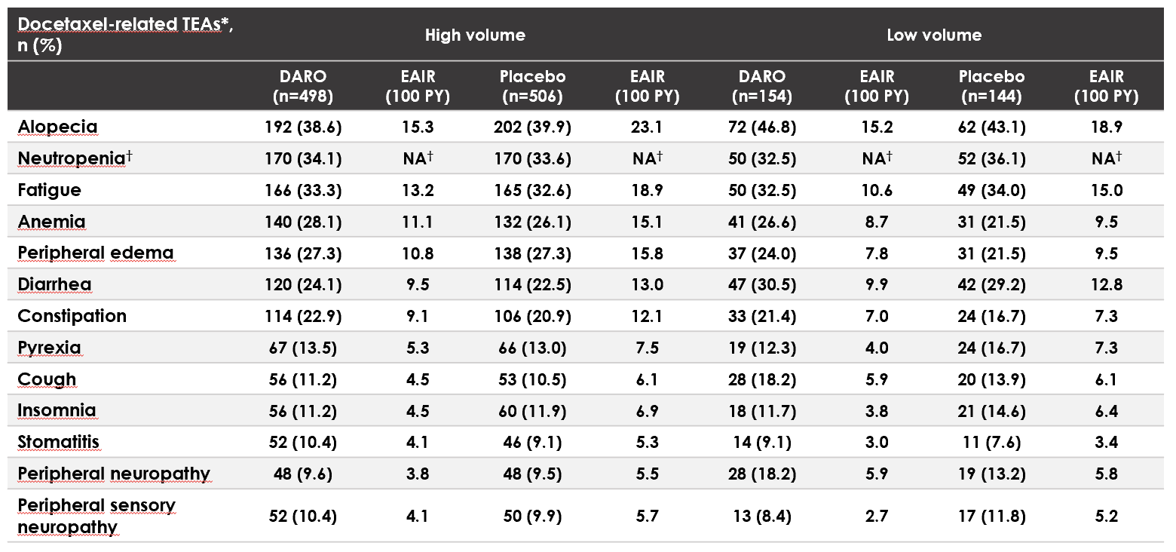
Triplet : Quels sont les patients pour qui le triplet peut être délétère ?
PEACE-1
ARASENS
Bas volume
+ effets secondaires
Novembre 2023

Slide 52
Est-ce un CPHSm haut volume ?
CPHSm
OUI
NON
Haut volume
Bas volume
Le patient est-il fit pour une chimio ?
Le patient peut-il recevoir une irradiation locale ?
OUI
NON
NON
OUI
HT + CHIMIO + NHT
Ou HT + NHT
HT + NHT
+/- RT prostatique
HT + NHT
HT + NHT
Avis d’experts G. Pignot / G. Gravis (d’après : Morgan A et al. JCO 2022)
Novembre 2023

Slide 53
Faut-il plutôt « désescalader » ?
Novembre 2023
Notes:
PEACE-6 (G.Baciarello, P.Blanchard, K Fizazi): 2 PHRC obtenus 1) PEACE-6 Oligo PRESTO (oligo, RXT) en cours d’inclusion, 2) PEACE-6 Vulnerable ouverture en Mars 2022 en France, 10 pts inclus. Soumis en Espagne et en Irlande. ➢ PEACE-6 Poor responders: Patients M1 avec PSA tardif élevé (G. Gravis/K.Fizazi): Rando 5 poursuite traitement systémique +/- PSMA-Lu, accord de Novartis, contrat bientôt signée
Projet d’essai PEACE-6 Good responders (S Supiot, G Roubaud, A Patrikidou): rando poursuite traitement systémique vs irradiation lésions résiduelles PET+ (+/- réduction durée TTT systémique) discussion avec le groupe international Desescalate(C Sweeney et B Tombal), réunion prévue le 13/10. Longue discussion en séance: en faveur de tester l’hypothèse d’un arrêt des deux hormonothérapies, +/- la même chose + irradiation des sites résiduels (intégration imageries nouvelle génération dans le suivi). A
discuter en session commune l’am.
Projet suite PEACE-6 Oligo (PRESTO): P3 randomisant la durée des NHT (jusqu’à progression vs 2 ans) pour des pts oligo sur imagerie de nouvelle génération (Alice Bernard- Tessier) 1200 pts nécessaire pour non infériorité

Slide 54
Faut-il plutôt « désescalader » ?
Valeur pronostique du PSA à 8 mois dans PEACE-1
SA+/-D + AAP
 | PSA à 8 mois
 | ≤0.2 ng/mL (n=243) | >0.2 ng/mL (n=198)
Médiane, a (95% CI) | NE (4,7-NE) | 2,2 (1,6-2,9)
Valeur p | <0,0001
Good responders
Désescalade thérapeutique ?
Survie sans progression radiologique
Poor responders
poursuite traitement systémique +/- PSMA-Lu (PEACE-6)
Délai à partir du PSA à 8 mois (années)
243
198
219
136
182
100
131
61
80
30
39
12
G. Gravis, et al., ESMO® 2022, Abs #1361MO
Novembre 2023
Notes:
Projet G. Gravis très bons répondeurs à 2 ans décroissance thérapeutique, analyser pet à 2 ans? Etude non RIPH ouverte à l’IPC.

Slide 55
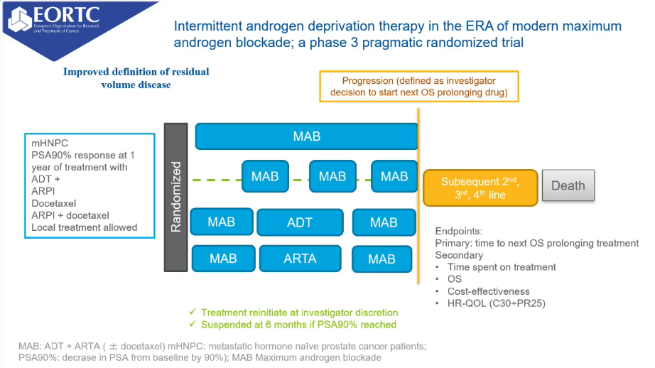
DE-ESCALATE
Intermittent Androgen deprivation therapy in the ERA of Androgen receptor PATHWAY inhibitors; A phase 3 pragmatic randomised trial
Novembre 2023

Slide 56

CONCLUSION
Deux salles, deux ambiances…
INTENSIFIER ?
Triplet à tout prix
Objectif oncologique
Haut volume+++
Gestion optimisée des effets secondaires
DESESCALADER ?
HT + NHT (voire intermittent)
Objectif : maintien QOL
Bas volume+++
Facteurs pronostiques pour
sélectionner les patients ?
Novembre 2023

