Slide 1

Dernières actualités sur les tumeurs mammaires
Highlights
2023
Compte-rendu
18th St Gallen
International Breast Cancer Conference 2023

Slide 2
Dernières actualités sur les tumeurs mammaires
Highlights
2023
Rédaction en Chef
Pr Joseph Gligorov
Institut Universitaire de Cancérologie AP-HP Sorbonne Université, Hôpital Tenon, Paris
Comité Scientifique et de Rédaction
Pr Frédérique PENAULT-LLORCA
Centre Jean-Perrin Clermont-Fd
Dr Caroline BAILLEUX
Centre Antoine Lacassagne Nice
Dr Thomas GRELLETY
CH Côte Basque Bayonne

Slide 3

Les biomarqueurs
Highlights
2023
Pr Frédérique PENAULT-LLORCA
Centre Jean-Perrin Clermont-Fd

Slide 4
Liens intérêt Frédérique Penault-Llorca
Personnels :
AbbVie, Amgen, Astellas,AstraZeneca, Bayer, BMS, Clovis, EISAI, Genomic Health, GSK, Illumina, Invitae, Lilly, MERCK lifa, MSD, Myriad, Nanostring, Novartis, Pfizer, Pierre-Fabre, Roche, Sanofi, Servier
Institutionnels :
AbbVie, AstraZeneca, Bayer, BMS, Genomic Health, Illumina, Lilly, MSD, Myriad, Nanostring, Novartis, Pfizer, Pierre-Fabre, Roche,
Invitation congrès :
AbbVie, AstraZeneca, Bayer, BMS, Gilead, MSD, Novartis, Pfizer, Roche

Slide 5
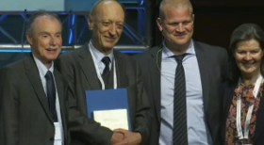
A tout seigneur, tout honneur
L’award du SGBCC 2023 a été remis à un pathologiste Beppe Viale
Viale a présenté l’histoire des biomarqueurs dans la prise en charge des cancers du sein depuis les récepteurs hormonaux jusqu’aux HER2 low, gBRCA, PD-L1, PIK3CA et les prochains …même s’ils concernent surtout les cancers du sein métastatiques
HER 3
Androgen receptors
ESR1 mutations
HER2 mutations
Anti-HER3 ADCs
Anti-androgen therapy
SERDs
TK-inhibitors; (ADCs)

Slide 6

A tout seigneur, tout honneur
L’award du SGBCC 2023 a été remis à un pathologiste Beppe Viale
Sa conclusion que je partage avec vous
Nous sommes suffisamment compétents pour identifier les patients candidats à différents traitements, mais nous sommes encore incapables de prédire qui y répondra et quelle sera l'ampleur du bénéfice.
Nous devons apprendre à prédire "l'ampleur du bénéfice" des différents traitements afin de les classer dans un ordre garantissant la plus grande efficacité.
  Nécessité de modèles prédictifs plus précis, probablement basés sur des approches nouvelles et plus sophistiquées (biopsie liquide, -omique, imagerie numérique, intelligence artificielle, ...

Slide 7

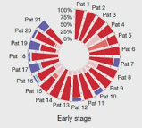

Parfaite transition avec la présentation de Fabrice André
Session 1 Translational research priorities for patient with early breast cancer
Importance des données de la protéomique spatiale pour mieux comprendre l’hétérogénéité tumorale et permettre des combinaisons thérapeutiques ad hoc.
Microbiote mammaire : taux de bactéries important dans les tumeurs du sein, role?
Chronobiologie : privilégier les prélèvements matinaux
Rôle encore à préciser de l’evaluation de la maladie résiduelle par biopsie liquide
Rôle grandissant de l’IA dans la prédiction du risque métastatique avec potentiellement un impact important en terme de coût

Slide 8
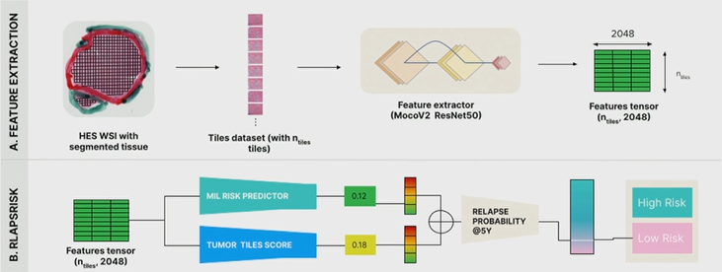
Deep Learning Assessment of Metastatic Relapse Risk from Digitized Breast Cancer Histological Slides

Slide 9
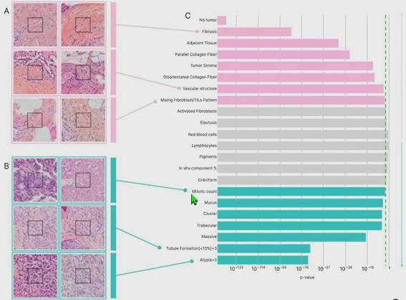
Model Interpretability

Slide 10
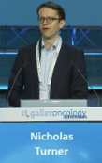
Session 2 Genomics, transcriptomics, ct DNA for disease monitoring and risk stratification
Dynamique des taux de Ct DNA et risque de rechute
Valeur pronostique à baseline
Valeur pronostique de la chute des ctDNA apres CTNA
Basline detection pre-neoadjuvant chemotherapy
iSPY2
iSPY2
HR: reference
HR: 2.1 (0.22-20.2)
HR: 22.4 (2.5-20.1)
UTILITE CLINIQUE ?
➔Pas encore dans les cancers du sein triple negatives !
ctDNA positive
ctDNA positive
Negative at T0
Log rank: P=0.0002
ctDNA negative
ctDNA negative
Clearance at T1, T2 or T3
No clearance at T3
Relapse Free Survival
Distant Recurrence-free Survival (proportion)
Distant Recurrence-free Survival (proportion)
Months from study entry
Time (years)
Time (years)
Nb à risque
39 | 39 | 31 | 21 | 7 | 4 | 1
41 | 39 | 34 | 15 | 7 | 2 | 0
Nb à risque
23 | 23 | 21 | 20 | 15 | 9 | 0 | 0
52 | 49 | 45 | 42 | 36 | 15 | 1 | 0
Nb à risque
20 | 20 | 18 | 17 | 16 | 8 | 0 | 0
29 | 27 | 25 | 24 | 21 | 12 | 0 | 0
5 | 4 | 3 | 2 | 1 | 1 | 0 | 0
Garcia-Murillas et al JAMA Oncol 2019
Magbanua et al Ann Oncol 2021
Magbanua et al Ann Oncol 2021

Slide 11

cTRAK-TN proof-of-principle trial
Early stage triple negative breast cancer
Neoadjuvant chemo - residual disease post chemo
Primary surgery-tumor > 20mm or node positive
Completed surgery and adjuvant chemotherapy
Design digital PCR ctDNA assays
Active ctDNA surveillance - double blind
Baseline ctDNA and 3 monthly util 12 months
+ve ctDNA
Primary endpoint ctDNA clearance
Randomize 2:1
Standard treatment
Staging +ve
Staging
Intervention
Pembrolizumab 200mg i.v. q3 weeks for 1 year
Monthly ctDNA samples for 12 monts
Observation
Continue standard follow-up ctDNA samples every 3 months to 24 months

Slide 12
ctDNA Surveillanec Results
161 patients in ctDNA surveillance. Median follow-up in study 20.4 months
Proportion ctDNA + by 12-monh time point: 27.3% (44/161, 95%CI: 20.6-24.9)
7 patients relapsed without prior ctDNA detection
All patients
Split by risk group
KM estimates ctDNA+ at 12 months:
High risk:
55.7% (95%CI 42.8-69.5)
Moderate risk
11.8% (95%CI 6.9-19.8)
KM estimate ctDNA+ at 12 months:
26.4% (95% CI 20.1-34.1)
Proportion ctDNA+
Proportion ctDNA+
Months from start of ctDNA surveillance
Months from start of ctDNA surveillance
Failure function

Slide 13
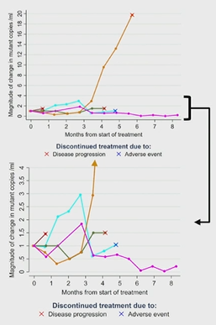
Treatment group
45 patients ctDNA positive and entered therapeutic trial
  14 allocated to observation
  32 allocated to pembrolizumab
Overt metastatic disease on staging at time of ctDNA detection 71.9% (23/32, 95%CI: 53.3-86.3)
Estimated 1.4% moderate and 28.5% high risk had metastatic disease by the time of baseline ctDNA assessment
No patients exhibited sustained ctDNA clearance 6 months after commencing pembrolizumab

Slide 14
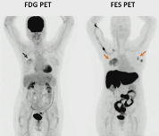
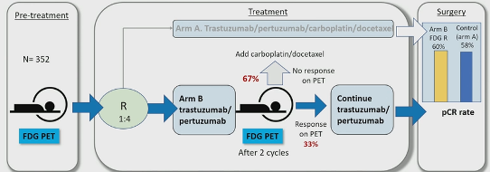
Session 2 Genomics, transcriptomics, ct DNA for disease monitoring and risk stratification
Molecular imaging in breast cancer
Michel van Krunchten
Department of Medical Oncology
University Medical Center Groningen the Netherland
Neoadjuvant PHERGain trial – exploratory scenario Can FDG PET select patients for chemotherapy de-escalation ?
Pre-planned exploratory analysis of optimal threshold for FDG PET
Raising the bar ≥77% decrease FDG uptake = response
FES PET relevance in early breast cancer
Limited data in early breast cancer
May improve staging in lobular subtype
  Correct staging in 85% with FES PET and 73% with FDG PET (n=40pts)
Extrapolation from MBC data → ER+ but FES-negative disease may benefit more from NAC than endocrine therapy
Iqbal et al. Cancer Res 2022 (Presented at SABCS 2021 [meting P3-02-11]) ; Covington et al. (Presented at RSNA 2021)
Association Zr-Pembrolizumab uptake & PFS
Association Zr-anti-CD8 uptake & OS
Log-rank P = 0.030
HR 2.4 (95% CI: 1.1-5.4)
Gebhart et al. Presented at ESMO Breast 2022
Autres développements : imagerie du microenvironnement (PD-L1, CD8)
Proportion surviving without progression (%)
Log-rank P = 0.0025
HR 5.3 (95% CI: 1.7-19.0)
Proportion surviving (%)
Encore peu d’études dans les cancer du sein précoces en dehors de TEP FDG et prediction de la response à la CT neoadj
Follow-up (months)
Follow-up (months)
SUV_{max} < 5.8
Nb à risque
9 | 3 | 1 | 1 | 1 | 1 | 1 | 0
9 | 8 | 8 | 8 | 5 | 3 | 2 | 1
Geometric mean SUV_{max} < 5.2
Nb à risque
17 | 9 | 4 | 2 | 2
17 | 15 | 9 | 4 | 2
SUV_{max} ≥ 5.8
Geometric SUV_{max} ≥ 5.2

Slide 15
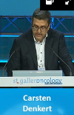
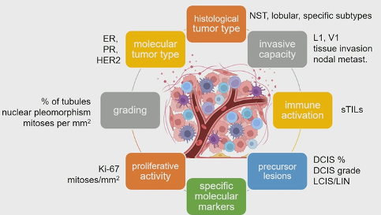
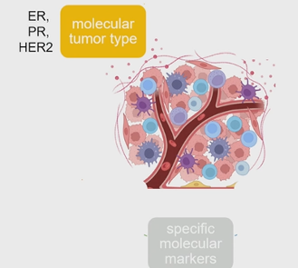
Session 3 Immunology in early breast cancer
Tumor microenvironnement in early breast cancer
Which parameters are relevant for clinical decisions? – all of them
Which classical parameters have been validated in prospective clinical trials ? ER, PR, HER2

Slide 16
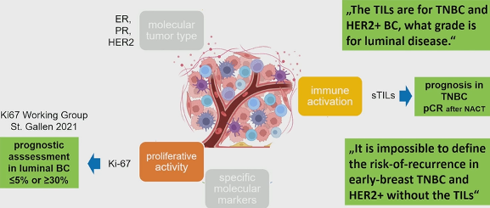
Session 3 Immunology in early breast cancer
Tumor microenvironnement in early breast cancer
What have we learned from TILs? – clinical strategies and pathology reporting
The TILs are for TNBC and HER2+, what grade is for luminal disease.
It is impossible to define the risk-of-recurrence in early TNBC and HER2+BC. Without TILs.
  TILs (and Ki67) are among the most extensive validaated classical biomarkers
  H&E slides: low cost, wiidely available woldwide
  WHO 2019, ESMO guideline 2023
Both parameters should be part of the standard histopathology report
  Prognostic assessment and basis for inclusion in clinical trials
New FDA CME course on TIL evaluation as well as extensive other training material
Which classical parameters have been validated in prospective clinical trial? ER, PR, HER2
Which additional histological parameters have the most extensive validation?

Slide 17
Session 4 hereditary breast cancer
Local treatment in pts with high risk hereditary breast cancer risk
Summary
Although BRCA1 and 2 represent the majority of P/LPV in High Risk BC, due to widespread use of MPG tests, clinicians face frequently results that they are not prepared to deal with
Main Stream testing is becoming routine in clinical practice (decisions need to be made swiftly - frequently skipping the genetic counselling pathway and support)
Patients with Early Breast cancer should not be denied BCS with identical OS when compared to Mastectomy but with higher rates of LR (longer follow-ups, new primaries)
CLBC incidence can be calculated using different formulas, helping in the decision to go or not for CLRRM (although no difference in OS has been proved)
Age, Menopausal status, Stage and Adjuvant treatments are very important in the decision of taking additional RR strategies
Revisiting the circuit of Hereditary Breast Cancer Patients will be crucial
MJ Cardoso

Slide 18
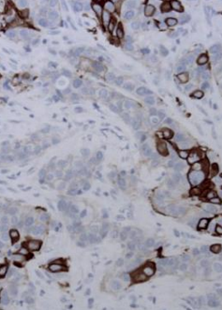
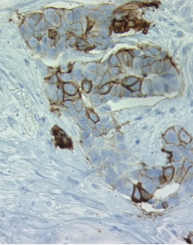
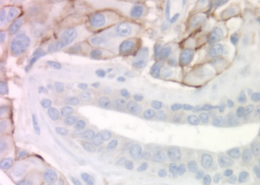
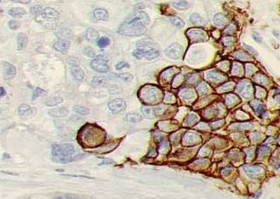
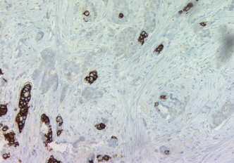
Session 5 HER2 positive breast cancer
Assessing HER2 heterogeneity (FPL)

Slide 19
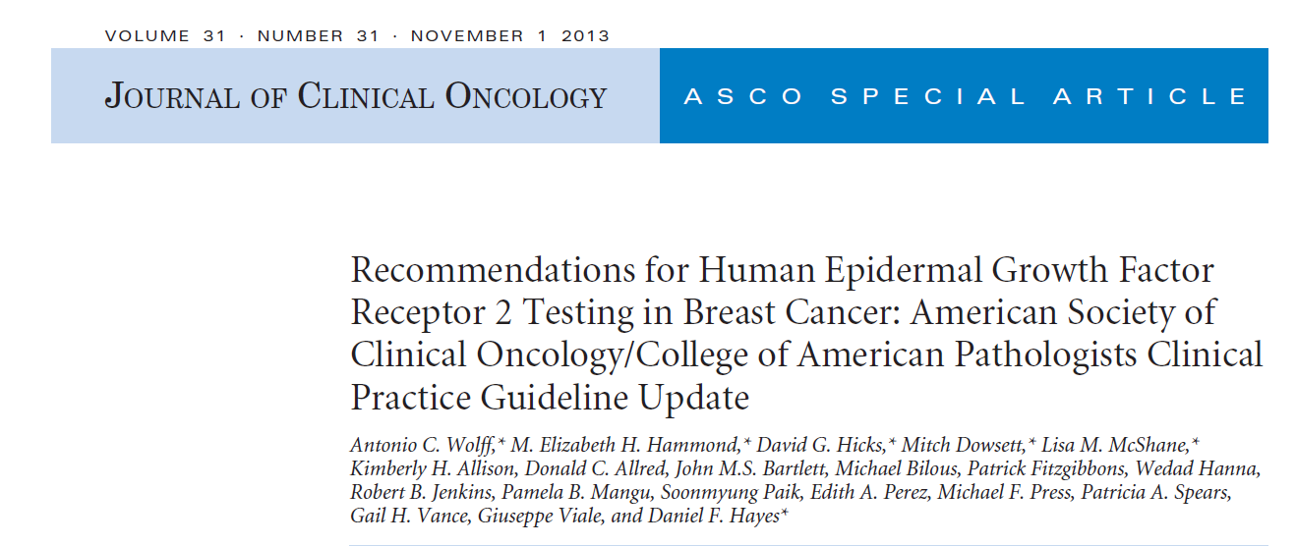
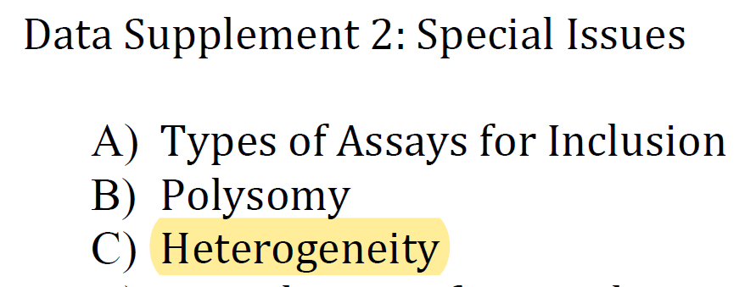
Definition of HER2 Heterogeneity
Introduction in ASCO/CAP guidelines in 2013 “Heterogeneity on ISH”
  Genomic heterogeneity refers to conditions where more than one population of tumor cells exists within the same tumor.
  3 options : discrete clones of amplified, diffuse intermingling of amplified and non-amplified cells, or isolated amplified cells in a predominantly non-amplified tumor.
  Experts contend that the only type of amplified population that is significant is the discrete aggregated cells.
  Any aggregate population of amplified cells comprising > 10% of the total tumor cell population on the slide must be separately counted (at least 2 tumor areas).
Wolff AC et al Journal of Clinical Oncology 2013. 31: 3997-4013

Slide 20

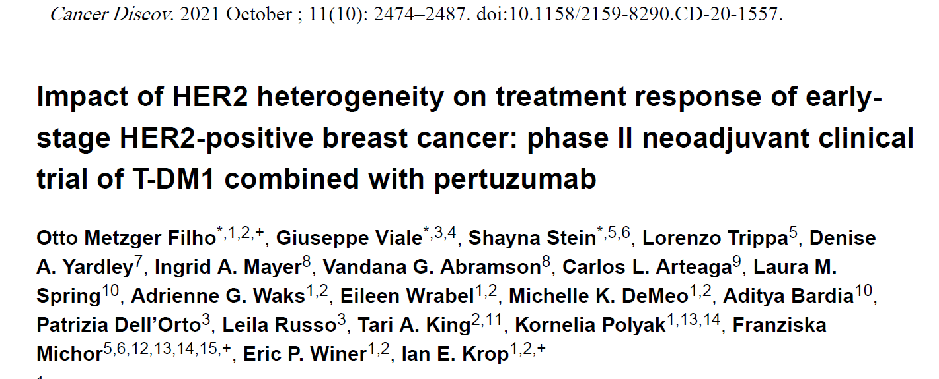
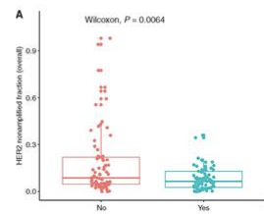
pCR
HER2 heterogeneity: (<5 ->50%) 10% (81% HR+)
P=0.0001
No pCR in the heterogeneous group vs 55% in the non heterogeneous group p=0.0001
pCR (%)
Pts without pCR ➔ higher overall fraction of ERBB2 non-amplified cells (p = 0.0064)
Nonhererogeneous
Hererogeneous

Slide 21

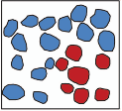

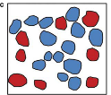

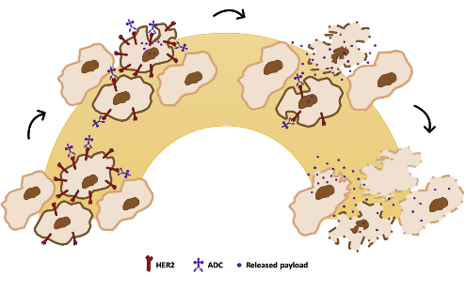
Conclusion
HER2 heterogeneity in HER2+ disease is a genomic event
Occurs in 5-30% of the cases depending on the definition (~10-15%)
Occurs more frequently in ER+ tumors, polysomic cases, with lower level HER2 amplification
Confers resistance to classical anti-HER2 therapies or T-DM1 in the neoadjuvant setting
But with ADCs with higher bystander effect, this resistance should be overcome!
Hanna W et al. Modern Pathology 2014;27:4-18Marchio C et al.Seminars in Cancer Biology 72 (2021) 123–135

Slide 22
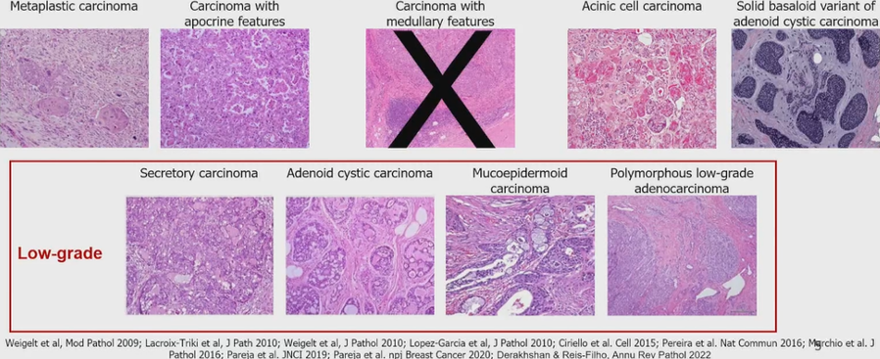
Session 9: optimizing treatment in pts with TNBC
Tackling triple negative histological subtypes in early breast cancer
Special types of triple-negative breast cancer
J Reis Filho

Slide 23
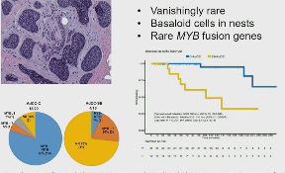
Session 9: optimizing treatment in pts with TNBC
Tackling triple negative histological subtypes in early breast cancer
Triple-negative apocrine carcinomas
  Enriched for luminal androgen receptor
  Low Ki67 (<20%) in >87%
  Low levels of TILs (<10%) in 90%
pCR after NAC: 0 to10%
Survival: better than TNBC in general
  93% overall survival at 62mo
Call to action and future perspectives
Histologic subtyping of TNBC is now essential
  Low-grade forms
  Apocrine carcinomas
Real world evidence studies
Consideration of international, multi-institutional trials focusing on specific TNBC histologic special types
Development of artificial intelligence algorithms to standardize the diagnosis of these rare entities
Solid basaloid variant of AdCC
J Reis Filho

Slide 24

TNBC
Highlights
2023
Dr Thomas GRELLETY
CH Côte Basque Bayonne

Slide 25
Liens intérêt Thomas GRELLETY
Advisory board/consulting
Novartis, BMS, MSD, Gilead, Amgen, Pierre Fabre, Lilly, GSK, Pfizer, Astra Zeneca, Daiichi-Sankyo, Seagen

Slide 26
18th St. Gallen international breast cancer conference 2023
Topic: Pathology
A 43 year old woman has undergone Lumpectomy for a 1.6 cm, node-negative, grade 3, triple negative breast cancer. The sTIL score is 75%. Which of the following would you recommend? .
Adjuvant Chemotherapy
87,93%
No adjuvant Chemotherapy given the favorable prognosis
8,62%
Abstain
3,45%

Slide 27
18th St. Gallen international breast cancer conference 2023
Topic: Pathology
Patient has undergone surgery for stage T1b TNBC measuring 0,8cmThe tumor has a high TIL >50%. Which of the following would you recommend? .
Adjuvant Chemotherapy
58,18%
No adjuvant Chemotherapy given the favorable prognosis
34,55%
Abstain
7,27%

Slide 28
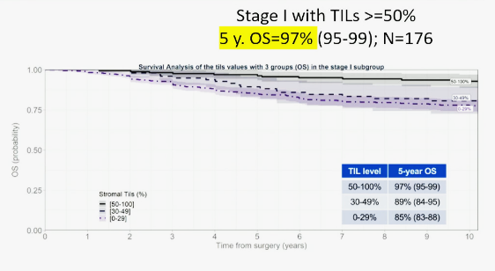
Chemotherapy-naïve TNBC:
Pool Analysis of 13 cohorts ( N=1966)
78% post- menauposal
87% N0
Tils locally assessed (www.tilsinbreastcancer.org)
Tow thresholds: ≥30% and 50%
  TILs ≥30% → 33% pts
  TILs ≥50% → 21% pts
Md FU : 30 years
Leon ferr, Flora Jonas, Salgado et al. SABCS 2022

Slide 29
18th St. Gallen international breast cancer conference 2023
Topic: Triple Negative Therapy
Carboplatin should be included in the chemotherapy regimen for patients receiving neoadjuvant therapy for stage 2 or 3 TNBC who are also receiving taxane, anthracycline, and cyclophosphamide based chemotherapy when pembrolizumab is being administered.
Oui
78%
Non
12%
Abstentions : 10%

Slide 30
18th St. Gallen international breast cancer conference 2023
Topic: Triple Negative Therapy
Carboplatin should be included in the chemotherapy regimen for patients receiving neoadjuvant therapy for stage 2 or 3 TNBC who are also receiving taxane, anthracycline, and cyclophosphamide based chemotherapy when pembrolizumab is not being administered.
Oui
72%
Non
16%
Abstentions : 12%

Slide 31
Add Carboplatin to neoadjuvant taxane/anthra?
Essai BrighTNess
Essai KN522
Phase Néoadjuvante
Phase Adjuvante
EFS (%)
Traitement néoadjuvant 1
(cycles 1-4; 12 sem)
Traitement néoadjuvant 2
(cycles 5-8; 12 sem)
Traitement adjuvant (cycles1-9; 27 sem)
Eligibilité
Age > 18 ans
Cancer du sein TN
T1c N1-2 ou N0-2
ECOG PS 0-1
Tissu disponible (PD-L1)
Carboplatine +
paclitaxel
Doxo/Epirubicine +
cyclophosphamide
Chirurgie
PEMBROLIZUMAB
200 mg
toutes les 3 sem
PEMBROLIZUMAB 200 mg
toutes les 3 sem
R
2:1
N=1174
Carboplatine +
paclitaxel
Doxo/Epirubicine +
cyclophosphamide
Temps, mois
PLACEBO
PLACEBO
Nb à risque
316 | 311 | 301 | 290 | 283 | 273 | 266 | 257 | 248 | 241 | 235 | 228 | 222 | 213 | 206 | 199 | 195 | 188 | 130 | 28 | 9 | 1 | 1 | 0
160 | 157 | 154 | 151 | 148 | 143 | 134 | 129 | 121 | 118 | 115 | 112 | 111 | 110 | 102 | 97 | 94 | 91 | 55 | 13 | 5 | 3 | 0
158 | 147 | 147 | 142 | 139 | 132 | 125 | 120 | 115 | 112 | 107 | 102 | 98 | 95 | 91 | 87 | 80 | 74 | 41 | 12 | 7 | 3 | 2 | 1 | 0
Stratification :
N (+ vs -)
Taille (T1/T2 vs T3:T4)
Carboplatine (hebdomadaire vs toutes les 3 semaines)
 | Paclitaxel + Carboplatine + Veliparib | Paclitaxel + Carboplatine | Paclitaxel
Evènements n/N 4-years EFS, HR (95% CI) | 65/316 78,2 (73,5-83,2) | 30/160 79,3 (72,9-86,2) | 47/158 68,5 (61,3-76,7)
Paclitaxel + Carboplatine + Veliparib vs Paclitaxel Paclitaxel + Carboplatine + Veliparib vs Paclitaxel + Carboplatine Paclitaxel + Carboplatine vs Paclitaxel (post hoc analysis | 0,63 (0,43-0,92), p=0,02 1.12 (0,72-1,72), p=0,62 0,57 (0,36-0,91), p=0,02
Geyer et al, Ann oncol 2022
P Schmid SABCS 2021

Slide 32
Adding a platinum agent to neoadjuvant chemotherapy for triple-negative breast cancer: the end of the debate
Study |  | Hazard ratio (95% CI)
Zhang (2016) |  | 0.72 (0.53-0.99)
GeparSixto GBG66 (2017) |  | 0.56 (0.33-0.96)
Wu (2018) |  | 0.21 (0.05-0.97)
CALGB 40603 Alliance (2019) |  | 0.99 (0.70-1.40)
GeparOcto GBG84 (2020) |  | 0.73 (0.47-1.13)
BrighTNess (2021) |  | 0.57 (0.36-0.91)
Overall (I-squared = 33.7%, p=0.183 |  | 0.70 (0.56-0.89)
0.04
0.1
0.25
0.5
1
2.5
Platinum
Controls
Study |  | Hazard ratio (95% CI)
Zhang (2016) |  | 0.85 (0.60-1.920)
GeparSixto GBG66 (2017) |  | 0.60 (0.32-1.12)
CALGB 40603 Alliance (2019) |  | 1.14 (0.78-1.69)
GeparOcto GBG84 (2020) |  | 0.66 (0.38-1.15)
BrighTNess (2021) |  | 0.63 (0.33-1.21)
Overall (I-squared = 19.8%, p=0.289 |  | 0.82 (0.64-1.04)
0.3
0.5
1
1.5
2
Platinum
Controls
Poglio et al. Ann Oncol 2022

Slide 33
18th St. Gallen international breast cancer conference 2023
Topic: Triple Negative Therapy
Multiple studies have suggested taht dose-dense adjuvant chemotherapy improves outcomes. For that reason, the ‘AC/EC’ phase of the KN522 regimen with concurrent pembrolizumab should be given every 2 weeks, and not every 3 weeks as was done in the clinical trial
Oui
29,23%
Unsure as safety efficacy confirmation needed before abandoning 3-weekly option
13,85%
Non
38,46%
Abstentions : 18,46%

Slide 34
Dose dense anthracycline
Any recurrence, ER-negative (10 900 women)
Breast cancer mortality, ER-negative (10 900 women)
Dose-intense
RR 0.86 (95% CI 0.79-0.93)
Lor-rank 2p<0.0002
10-year gain 3.1% (95% CI 1.3 to 5.0)
Standard schedule
RR 0.85 (95% CI 0.80-0.92)
Lor-rank 2p<0.0001
10-year gain 3.7% (95% CI 1.7 to 5.8)
36.7%
30.1%
32.9%
27.2%
Recurrence (%)
26.1%
Recurrence (%)
20.2%
24.1%
17.7%
Recurrence rate per year (%) and log-rank analyses
Allocation | Years 0-4 | Years 5-9 | Years ≥ 10
Dose-intense | 6.32 (1374/21741 | 1.99 (213/10342) | 1.50 (64/4266)
Standard schedule | 7.45 (1593/21390) | 2.10 (217/10342) | 1.50 (66/4387)
Rate ratio (95% CI) from | 0.84 (0.77-0.91) | 0.94 (0.75-1.12) | 0.98 (0.63-1.33)
(O-E)/V | -119.8/671.3 | -6.6/103.5 | -0.7/31.7
Recurrence rate per year (%) and log-rank analyses
Allocation | Years 0-4 | Years 5-9 | Years ≥ 10
Dose-intense | 3.92 (3.67-4.18) | 1.76 (1.52-1.99) | 0.77 (0.55-1.00)
Standard schedule | 4.47 (4.20-4.74) | 2.07 (1.82-2.33) | 0.82 (0.59-1.04)
Rate ratio (95% CI) from | 0.86 (0.78-0.95) | 0.83 (0.66-1.00) | 0.94 (0.54-1.34)
(O-E)/V | -68.3/463.1 | -20.9/111.7 | -1.4/22.5
Early Breast Cancer Trialists' Collaborative Group (EBCTCG) . Lancet 2019

Slide 35
Anthra 2 or 3weeks?
KN522
 | Évènements | HR (95% CI)
Pembro + CT / Pembro | 15.6% | 0.65 (0.50-0.85)
Pbo + CT / Pbo | 23.1%
84.6%
77.5%
Essai KN522
EFS (%)
Phase Néoadjuvante
Phase Adjuvante
Traitement néoadjuvant 1
(cycles 1-4; 12 sem)
Traitement néoadjuvant 2
(cycles 5-8; 12 sem)
Traitement adjuvant (cycles1-9; 27 sem)
Eligibilité
Age > 18 ans
Cancer du sein TN
T1c N1-2 ou N0-2
ECOG PS 0-1
Tissu disponible (PD-L1)
Carboplatine +
paclitaxel
Doxo/Epirubicine +
cyclophosphamide
Chirurgie
PEMBROLIZUMAB
200 mg
toutes les 3 sem
PEMBROLIZUMAB 200 mg
toutes les 3 sem
R
2:1
N=1174
Carboplatine +
paclitaxel
Doxo/Epirubicine +
cyclophosphamide
Temps, mois
PLACEBO
PLACEBO
Nb à risque
 | 784 | 781 | 771 | 754 | 731 | 720 | 704 | 694 | 683 | 672 | 652 | 551 | 433 | 303 | 165 | 28 | 0 | 0
 | 390 | 386 | 384 | 377 | 364 | 348 | 332 | 323 | 313 | 307 | 299 | 251 | 196 | 141 | 84 | 17 | 0 | 0
Stratification :
N (+ vs -)
Taille (T1/T2 vs T3:T4)
Carboplatine (hebdomadaire vs toutes les 3 semaines)
P. Schmid, et al., SABCS® 2021, Abs #GS1-01

Slide 36
18th St. Gallen international breast cancer conference 2023
Topic: Triple Negative Therapy
A healthy premenopausal woman has received taxane/carboplatin followed by AC chemotherapy, with concurrent pembrolizumab, as neoadjuvant treatment for TNBC. If she has a pCR should she also receive adjuvant pembrolizumab?
Oui
58,49%
Non
32,08%
Abstentions : 9,43%

Slide 37
EFS by pCR (ypT0/Tis ypN0)
94.4%
pCR Yes
92.5%
67.4%
pCR No
56.8%
EFS by pCR (%)
Temps, mois
Pembro + Chemo/Pembro Responder
Nb à risque
494 | 494 | 494 | 489 | 483 | 482 | 478 | 477 | 472 | 470 | 460 | 387 | 307 | 220 | 122 | 18 | 0 | 0
217 | 217 | 217 | 216 | 214 | 207 | 206 | 203 | 200 | 200 | 197 | 165 | 130 | 87 | 56 | 9 | 0 | 0
290 | 287 | 275 | 262 | 245 | 236 | 224 | 215 | 209 | 201 | 192 | 164 | 126 | 83 | 43 | 10 | 0 | 0
173 | 169 | 165 | 152 | 144 | 135 | 122 | 116 | 110 | 104 | 100 | 85 | 65 | 53 | 27 | 8 | 0 | 0
Pbo + Chemo/Pbo Responder
Pembro + Chemo/Pembro Non-Responder
Pbo + Chemo/Pbo Non-Responder
P Schmid ESMO virtual plenary 2021

Slide 38

Are there predictive biomarkers of sensitivity to ICI?
Correlative studies from KN522
H Bonnefoi, SGBCC 2023

Slide 39
L’étude KEYNOTE 522
Immune-Mediated Aes and Infusion Reactions inn Combined Phases
Grade
1-2
3-5
 | Pembro + Chemo / Pembro (n=783) | Pbo + Chemo / Pbo (n=389)
Any grade | 43.6% | 21.9%
Grade 3-5 | 14.9% | 2.1%
Serious | 10.6% | 1.3%
Led to death | 0.3% | 0
Led to discontinuation | 10.9% | 2.6%
Pembro+Chemo/Pembro
18.0
Pbo+Chemo/Pbo
15.1
11.6
Incidence (%)
5.7
5.7
5.2
1.8
2.6
2.2
1.5
2.0
1.3
1.9
1.7
1.4
2 décès groupe pembro
1 décès lié à une pneumopathie +
1 à encéphalite auto-immune
1.0
0.3
0.8
0.8
0
Infusion reactions
Hypothyroidism
Severe skin reactions
Hyperthyroidism
Adrenal insufficiency
Pneumonitis
Thyroiditis
Hypophysitis
Colitis
Hepatitis
+ questions coûts financier….
Immune-Mediated Aes and Infusion Reactions with Incidence ≥ 10 Patients
P Schmid SABCS 2021

Slide 40
Désescalade de la partie adjuvante du pembrolizumab
pCR
OptimICE-pCR
Key Eligibility:
pCR after preop chemo x min 6 cycles with pembrolizumab
Pembrolizumab x 27 wks
R
Observation
Planned Study Through Alliance
La réponse viendra des patientes inclues dans les essais !!

Slide 41
18th St. Gallen international breast cancer conference 2023
Topic: Triple Negative Therapy
Should we use neoadjuvant pembrolizumab-based chemotherapy for stage 1 TNBC
Oui
4,62%
No, ‘chemotherapy only’ is appropriate neoadjuvant treatment for small TNBC tumors
46,15%
No, I recommend primary surgery for small TNBC that do not clinically have indication for neoadjuvant treatment, and then make chemotherapy recommendations
41,54%
Abstentions : 7,69%

Slide 42
18th St. Gallen international breast cancer conference 2023
Topic: Triple Negative Therapy
A healthy 60 year old woman has a clinical T2N0 triple negative breast cancer, of about 2-3 cm in size. She is a candidate for BCS without needing neoadjvant therapy. Your preferred approach would be:
Neoadjuvant chemotherapy and pembrolizumab
64,62%
Neoadjuvant chemotherapy
21,54%
Surgery
7,69%
Abstentions : 6,15%

Slide 43
Analyses en sous-groupes
Survie sans événement
 |  |  | Nb. d’évènmts / Nb. de patients (%)
Analyses EFS |  | Hazard ratio (95% CI) | Pembro + CT / Pembro | Pbo + CT / Pbo | Hazard ratio (95% CI)
Analyse primaire |  |  | 123/784 (15.7) | 93/390 (23.8) | 0.63 (0.48 to 0.82)
Statut ganglionnaire | Négatif |  | 80/406 (19.6) | 57/196 (29.1) | 0.65 (0.46 to 0.91)
 | Positif |  | 43/376 (11.4) | 36/194 (18.6) | 0.58 (0.37 to 0.91)
Stade de la maladie | Stade II |  | 65/590 (11.7) | 54/291 (18.6) | 0.60 (0.42 to 0.86)
 | Stade III |  | 54/194 (27.8) | 39/96 (39.8) | 0.68 (0.45 to 1.03)
Statut ménopausique | Pré-ménopause |  | 60/438 (13.7) | 47/221 (21.3) | 0.62 (0.42 to 0.91)
 | Post-ménopause |  | 63/345 (18.3) | 46/169 (27.2) | 0.64 (0.44 to 0.93)
Statut HER2 | 2+ by IHC (but FISH) |  | 32/188 (17.0) | 24/104 (23.1) | 0.73 (0.43 to 1.24)
 | 0-1+ by IHC |  | 91/595 (15.3) | 69/286 (24.1) | 0.60 (0.44 to 0.82)
LDH | >ULN |  | 29/149 (19.5) | 23/80 (28.8) | 0.65 (0.37 to 1.12)
 | ≤ULN |  | 93/631 (14.7) | 69/309 (22.3) | 0.63 (0.46 to 0.86)
EFS
N+: 80.7 vs 71.5%; △ 9.2%
N-: 88.6 vs 82.2%; △ 6.4%
II: 88.6 vs 81.7%; △ 6.9%
III: 71.8 vs 62;% △ 9.8%
1.0
0.5
1.0
1.5
Bénéfice Pembro + CT / Pembro
Bénéfice Pbo + CT / Pbo
Bénéfice du pembrolizumab dans tous les sous-groupes !
P. Schmid, et al., SABCS® 2021, Abs #GS1-01

Slide 44
Todays Roadmap for Early TNBC
Capecitabine
Wild type
T1c, N0
Taxane/platinum vs T/AC
No pCR
Pembrolizumab
Neoadjuvant therapy
gBRCA mut
Olaparib x one year
Non-anthracycline regimens?
Surgery
No further therapy
T≥2cm, any N+
Tca/AC + pembrolizumab
pCR
Complete one year pembrolizumab?
T1a/b, N0
Surgery
+/- chemotherapy
Taxane/carboplatin vs docetaxel/cyclophosphamide
gBRCA mutation: neoadjuvant PARP inhibitors?
Hope S Rugo , SGBCC 2023

Slide 45
18th St. Gallen international breast cancer conference 2023
Topic: Triple Negative Therapy
A 45 year old woman has undergone primary surgery for TNBC, disclosing a stage 2 cancer with positive nodal involvement. In addition to standar chemotherapy, should she receive adjuvant pembrolizumab?
Oui
30%
Non
62%
Abstentions : 8%

Slide 46
18th St. Gallen international breast cancer conference 2023
Topic: BRCA Associated
A 43 year old patient has been diagnosed with stage 2, node-positive TNBC. She is also found to have a BRCA1 mutation. She receives neoadjuvant KN522. At surgery, she has residual disease. In the adjuvant setting, in addition to pembrolizumab, she should receive:
Capecitabine
2%
Olapariv
62%
Each, given in sequence
24%
Abstentions : 12%

Slide 47
OLYMPIA trial : adjuvant olaparib in gBRCAm
Randomized phase III trials : 1836 patients
BRCA 1 or 2 germline mutation
Olaparib 300 mg twice a day 1 year Vs placebo
HR - high risk definition: N+ post surgery or T>2cm OR no PCR post neoadjuvant CT
93.3
89.2
85.9
88.4
81.5
77.1
Différence : IDFS à 3 ans
8.8% (IC95%: 5.0%, 12.6%)
Différence : IDFS à 4 ans
7.3% (IC95%: 3.0%, 11.5%)
Invasive disease-free survival (%)
Olaparib (106 évts)
Placebo (178 évts)
HR Stratifié 0.58 (IC 95% : 0.41-0.82); p<0.0001
Tps depuis la randomisation (mois)
Nb. à risque
Olaparib | 921 | 820 | 737 | 607 | 477 | 361 | 276 | 183
Placebo | 915 | 807 | 732 | 585 | 452 | 353 | 256 | 173
A.N.J. Tutt, et al., ESMO2021, Abs #LBA1

Slide 48
Todays Roadmap for Early TNBC
Capecitabine
Wild type
T1c, N0
Taxane/platinum vs T/AC
No pCR
Pembrolizumab
Neoadjuvant therapy
gBRCA mut
Olaparib x one year
Non-anthracycline regimens?
Surgery
No further therapy
T≥2cm, any N+
Tca/AC + pembrolizumab
pCR
Complete one year pembrolizumab?
T1a/b, N0
Surgery
+/- chemotherapy
Taxane/carboplatin vs docetaxel/cyclophosphamide
gBRCA mutation: neoadjuvant PARP inhibitors?
Hope S Rugo , SGBCC 2023

Slide 49

Traitements anti-hormonaux
Highlights
2023
Dr Caroline BAILLEUX
Centre Antoine Lacassagne Nice

Slide 50
Liens intérêt Caroline BAILLEUX
Lilly, Pfizer, Novartis, Viatris, Seagen, AstraZeneca et Daiichi

Slide 51
18th St. Gallen international breast cancer conference 2023
Topic: Local-Regional Recurrence After Bcs/Rt
A patient has developed isolated local regional recurrence 4 year after initial diagnosis while on adjuvant aromatase inhibitor therapy. The tumor is strongly ER positive and HER2 negative. A staging work up is negative. The recurrence is fully exised and receives definitive local therapy. When originally diagnosed, she had not received adjuvant chemotherapy. Would you recommend genomic signature testing to decide whether to receive chemotherapy?
Yes, to determine suitability for chemotherapy
9,09%
No, because will recommend chemotherapy regardless given resistance to ET
14,55%
No, because would not recommend chemotherapy
16,36%
No, because will make clinical decision on others factors (grade, Ki67, PR status, age)
52.73%
Depends on size of recurrent lesion
1,82%
Abstentions : 5.45%

Slide 52
18th St. Gallen international breast cancer conference 2023
Topic: Local-Regional Recurrence After Bcs/Rt
A patient has developed isolated local regional recurrencewhile on adjuvant aromatase inhibitor therapy. The currence is fully exised and receives definitive local therapy. The preferred ongoing endocrine treatment is:
None
1,82%
Switch from NS-AI to exemestane, or vice-versa
16,36%
Ongoing AI with CDK4/6i
5,45%
Switch to fulvestrant
12.73
Switch to fulvestrant and CDK4/6i
20%
Switch to tamoxifen
23,64%
Switch to tamoxifen and CDK4/6i
9,09%
Abstentions : 10,91%

Slide 53
18th St. Gallen international breast cancer conference 2023
Topic: Adjuvant Endocrine Therapy
For a patient with stage 2, ER positive, HER2 negative breast cancer, a genomic assay should be used, if readily available, to determine the duration of ET
Oui
30,30%
Non
60,61%
Abstentions : 9,09%

Slide 54
18th St. Gallen international breast cancer conference 2023
Topic: Adjuvant Endocrine Therapy
Adjuvant abemaciclib should be recommended based on tumor stage and histology, irrespective of Ki67 expression
Vrai
77,27%
Faux
13,64%
Abstentions : 9,09%

Slide 55
Etude Monarch E - Survie sans maladie infiltrante
92,7%
Patient population
Node positive AND high risk or Ki67 ≥ 20%
N=5637
89,2%
89,9%
85,8%
Survie sans maladie invasive (%)
84,4%
79,4%
Abemaciclib Duration
Abemaciclib x 2 years ET x 5+ years
ET alone x 5+ years
Mois après la randomisation
Nb à risque
 | 2 808 | 2 620 | 2 548 | 2 478 | 2 407 | 2 345 | 2 214 | 1 229 | 521 | 79 | 0
 | 2 829 | 2 652 | 2 572 | 2 472 | 2 374 | 2 281 | 2 103 | 1 201 | 512 | 82 | 0
Réduction de 33,6 % du risque de développer un événement IDFS avec
une augmentation du bénéfice absolu dans les taux d'IDFS à 4 ans (6,4 %)
par rapport aux taux d'IDFS à 2 et 3 ans (2,8 % et 4,8 % respectivement).
Johnston S, et al., SABCS® 2022, Abs #GS1-09

Slide 56
Etude Monarch E - Survie globale
Overall survival: currently no evidence of harm
Survie
Nombre d'événements SG
Abemaciclib + ET | ET seul
157 | 173
HR (95% CI): 0.929 (0.748, 1.153) Log-rank P = 0.5027
Survie sans maladie invasive (%)
Nombre de patients
Temps (mois)
Nombreà risque
 | 2 808 | 2665 | 2613 | 2564 | 2516 | 2453 | 2343 | 1330 | 573 | 87 | 0
 | 2 829 | 2704 | 2663 | 2598 | 2544 | 2494 | 2357 | 1361 | 578 | 93 | 0
Moins de décès (157 vs 173) ont été observés dans le groupe
groupe abemaciclib plus ET par rapport au groupe ET
Johnston S, et al., SABCS® 2022, Abs #GS1-09

Slide 57
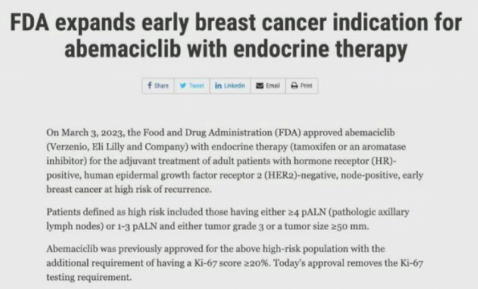
Updated abemaciclib adjuvant approval – US FDA 3/3/23
KI-67 requirement dropped
Current indication:
4 or more positive LN
1-3 positive LN and either
Tumor grade 3 or tumor size ≥ 5 cm

Slide 58
18th St. Gallen international breast cancer conference 2023
Topic: Adjuvant Endocrine Therapy
A patient with ER positive, grade 2 breast cancer has undergone surgery and SLN biopsy for 2.3 cm tumor, with a macrometastasis affecting 1 of 1 SLN. She will get chemotherapy and endocrine therapy. Which of the following would you recommend?
No further treatment
44,44%
Axillary dissection to see if additional LN are positive to inform choice of abemaciclib
35,56%
Adjuvant abemaciclib
6,67%
Abstentions : 13,33%

Slide 59
18th St. Gallen international breast cancer conference 2023
Topic: ER positive, chemotherapy decisions
Based on the subset data from MINDACT, TAILORx, and RxPonder, women age 50 or less, who are premenopausal, with ER positive stage 1 or 2 breast cancer do not need tumor genomic signature profiling because they benefit from chemotherapy.
Vrai
12,77%
Faux
76,60%
Abstentions : 10,64%

Slide 60
Woman with early-stage invasive breast cancer
HER2 POS
HER2 NEG
No mature evidence to recommend use of any other biomarker for this patient population
ER POS
ER NEG
Premenopausal or age ≤ 50 years
Postmenopausal or age > 50 years
No mature evidence to recommend use of any other biomarker for this patient population
Node NEG
Node POS
Node NEG
Node POS
Oncotype DX uPa and PAI-1
Insufficient evidence to recommend a biomarker for use
Oncotype DX
MammaPrint
EndoPredict
Prosigna
Ki67
IHC4
BCI
uPa and PAI-1
1-3 node POS
≥ 4 node POS
Oncotype DX
MammaPrint
Ki67
EndoPredict
IHC4
BCI
Insufficient evidence to recommend a biomarker for use

Slide 61
18th St. Gallen international breast cancer conference 2023
Topic: ER positive, chemotherapy decisions
A 47 year old premenopausal woman has been diagnosed with a screen detected, ER positive, PR positive, HER2 negative breast cancer. The tumor is 1.6 cm, grade 2, and node-positive, affecting 1 or 3 SLN. The recurrence score is 11. You would recommend:
Tamoxifen
17,65%
OFS and Tamoxifen
23,53%
OFS and AI
29,41%
Chemotherapy then ET
29,41%
Abstentions : 0%

Slide 62
IDFS en fonction du RS et du statut ménopausique
Ménopausée
Non ménopausée
RS 0-13
RS 0-13
No Statistically Significant IDFS Difference
5-year IDFS Absolute Difference 3.9%
RS 14-25
RS 14-25
No Statistically Significant IDFS Difference
5-year IDFS Absolute Difference 6.2%
K. Kalinsky, et al., SABCS® 2020, Abs #GS3-00

Slide 63
IDFS en fonction du nb de ganglions et du statut ménopausique
Ménopausée
Non ménopausée
1 ganglion
1 ganglion
No Statistically Significant IDFS Difference
5-year IDFS Absolute Difference 5.2%
2-3 ganglions
2-3 ganglions
No Statistically Significant IDFS Difference
5-year IDFS Absolute Difference 5.1%
K. Kalinsky, et al., SABCS® 2020, Abs #GS3-00

Slide 64
18th St. Gallen international breast cancer conference 2023
Topic: ER positive, chemotherapy decisions
A 57 year old woman has been diagnosed with a screen-detected breast cancer. She undergoes breast conserving surgery and SNB. The thumor is 0.7 cm, grade 2, ER positive, PR low-positive, and HER2 negative, and node-negative. A MammaPrint assay was set and returned high risk. Would you recommend chemotherapy:
Oui
26,53%
Non
69,39%
Abstentions : 4,08%

Slide 65
18th St. Gallen international breast cancer conference 2023
Topic: ER positive, chemotherapy decisions
A 57 year old woman has been diagnosed with a screen-detected breast cancer. She undergoes breast conserving surgery and SNB. The thumor is 1.7 cm, grade 2, ER positive, PR low-positive, and HER2 negative, and node-negative. She is willing to take chemotherapy if there is some benefit. The recurrence score is 26. Would you give chemotherapy?
Oui
78,46%
Non
15,38%
Abstentions : 6,15%

Slide 66
18th St. Gallen international breast cancer conference 2023
Topic: ER positive, chemotherapy decisions
A 34 year old premenopausal woman has been diagnosed with a palpable, ER positive, PR positive, HER2 negative breast cancer. The tumor is 1.6 cm, grade 2, and node-negative. The recurrence score is 12. You would recommend:
Tamoxifen
29,17%
OFS and Tamoxifen
25%
OFS and AI
31,25%
Chemotherapy then ET
14,58%
Abstentions : 0%

Slide 67
ASTRRA : Schéma de l’étude
Critères inclusion
Femmes préménopausées
Age ≤45 ans
HR + stade I-III cancer du sein
Traitées par chirurgie et chimiothérapie
WHO performance statut of 0-2
Tamoxifène 20 mg/jour (5 ans)+
Gosereline 3,6mg/28jour(2 ans)
n=635
Evaluation de la fonction ovarienne
R
1:1
n=1282
Tamoxifène 20 mg/jour (5 ans)
n=647
Evaluation fonction ovarienne :
FSH ≥ 30mlU/mL
Evaluation tous les 6 mois pendant 2 ans
Aménorrhée pendant 2 ans
Groupe avec ménopause confirmée exclu de l’analyse
Objectifs :
Principal: Survie sans récidive (SSR)
Secondaire: Survie globale (SG)
Kim HA and NOH WC et al., JCO 2019

Slide 68
ASTRRA : Objectif principal – Survie Sans Récidive
88,3%
84,1%
Δ 6%
86,2%
78,1%
Survie sans progression (%)
 | TAM | TAM + SO
SSR médiane(%) | 84,1 | 78,1
HR stratifié (IC95%) | 0,67 (0,516 to 0,872)
p Log Rank stratifié | 0,0025
Δ 2,1%
(Mois)
N° of patients à risque (événements)
TAM seul | 647 | 634 | 612 | 586 | 563 | 511 | 472 | 427 | 356 | 242 | 127 | 42
TAM+SO | 635 | 626 | 604 | 579 | 551 | 519 | 480 | 443 | 368 | 253 | 124 | 36
TAM Monothérapie
TAM+SO, Tamoxifène + Suppression ovarienne
K. H. Jeong, et al., ASCO® 2022, Abs #506

Slide 69
SOFT-TEXT (n=4690)
SOFT (n=3047)
OS + exemestane vs OS + Tamoxifen
(ITT) population 12-year
DFS (4.6% absolute improvement, HR=0.79; 95%CI, 0.70-0.90; P<0.001)
DRFI (1.8% absolute improvement, HR=0.83; 95%CI, 0.70-0.98; P=0.03)
Overall survival (90.1% vs 89.1%, HR=0.93; 95%CI, 0.78-1.11)
Significant OS improvement in
Women < 35 years (4.0%)
Tumor > 2 cm (4.5%)
Grade 3 tumor (5.5%)
Tamoxifen vs OS + Tam vs OS + AI
(ITT) population 12-year
Tamoxifen 71.9%
OS + Tam 76.1%
OS + exemestane 79.0%
Tamoxifen + OFS vs tamoxifen (HR=0.82; 95%CI 0.69-0.98) with
Overall survivall
Tamoxifen 86.8%
OS + Tam 89.0%
OS + exemestane 89.4%

Slide 70
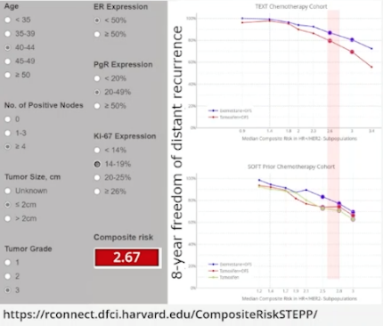
Premenopausal Woman
Optimum Endocrine Treatment
A Tool to Inform Treatment Decisions
Example
42 years, pT1c N2 M0
ER 40%, PR 25%, KI67 19%
OFS ?
Tamoxifen or aromatase inhibitor?
Exemestane > tamoxifen
(+GnRH analog)
OFS + exemestane >
OFS + tamoxifen >
tamoxifen

Slide 71

Cancers du sein HER2 positifs
Phase précoce
Highlights
2023
Pr Joseph GLIGOROV
Institut Universitaire de Cancérologie
AP-HP Sorbonne Université,
Hôpital Tenon, Paris

Slide 72
Liens intérêt Joseph GLIGOROV
Research and Care support:
Eisai, Exact Science, Roche Genentech
Consultancy honoraria:
Daiichi, Eisai, Exact Science, Eva Pharm, Lilly, Merck, Novartis, Onxeo, Pfizer, Roche Genentech, Seattle Genetics, Sothema
Other (institutions & associations) :
Sorbonne Université, AP-HP, Inserm (Employeurs et affiliations principales), Cours de Nice St Paul de Vence (responsabilité de programme de formation continue et de recommandations), ESMO®, ESO®, ABC®, AROME®, SoFOM®, SFMPP®, SPCC® (membre de sociétés savants et associations médicales), Alliance Contre le Cancer, Vaincre le Cancer (associations de soutien à la recherche et aux soins)
Family relationship: no
Stock options: no

Slide 73
18th St. Gallen international breast cancer conference 2023
Traitement adjuvant « bas risque »
Pour une patiente ayant un cancer du sein stade I, HER2 positif, le traitement adjuvant préféré est :
TCHP (docetaxel, carboplatine, trastuzumab, pertuzumab
4,62%
TH (Paclitaxel Trastuzumab)
84,62%
TDM1 (Trastuzumab emtansine)
0,00%
Abstention
10,77%

Slide 74
Dix ans de recul avec l’essai APT
 | ER-negative at baseline |  | ER-positive at baseline
DFS EVENT | N | Time to event (months) | N | Time to event (months)
Local/regional recurrence Ipsilateral axillia (HER2+) Ipsilateral breast HER2+ HER2- | 3 1 2 1 1 | 20 12,153 | 2 0 2 1 1 | 37,65
Contralateral breast events HER2+ HER2+ | 4 0 4 | 36, 59, 84, 90 | 5 1 4 | 12, 56, 88, 106, 130
Distant recurrence | 1 | 63 | 6 | 27,46, 54, 59, 81, 86
Death Breast-cancer related Non-breast cancer related | 6 0 6 | 42, 45, 52 ,62, 62, 119 | 9 0 9 | 14, 21, 48, 61, 62, 63 79, 106, 107
Any recurrence or death | 13 |  | 23
Stratum | N Events | 10-years IDFS | 95 % CI
Negative | 10 | 90.6% | 85.1%-96.4%
Positive | 19 | 91.6% | 88.0%-95.4%
HR (95% CI): 0.83 (0.40-1.72)
IDFS probabilty
Years
Number at risk
134 | 126 | 119 | 97 | 66 | 65 | 16 | 3
272 | 259 | 244 | 244 | 168 | 151 | 36 | 2
10y IDFS
90.2% (95% CI, 86.3%-94.3%) in HR+
88.5% (95% CI, 82.4%-95.1%) in HR-
10y RFI 96.8% (95% CI; 95.0%-98.7%)
10y OS 94.2% (95% CI; 91.6%-96.8%)
10y BCSS 99.1% (95% CI; 98.1%-100.0%)
Tolanay S. et al. SABCS 2012

Slide 75
Valeur pronostique de la pCR
HER2+
HER2+ HR+
HER2+ HR-
Event Free Survival Probability
Event Free Survival Probability
Event Free Survival Probability
HR=0.39, p < 0.001
HR=0.58, p < 0.001
HR=0,25 p < 0.001
pCR (n=586)
pCR (n=247)
pCR (n=235)
no pCR (n=1403)
no pCR (n=839)
no pCR (n=510)
Months since Randomization
Months since Randomization
Months since Randomization
50
30
31
34
16
18
7
Grade 1-2
Grade 3
No Tras
Yes Tras
No Tras
Yes Tras
HR+
HER2 +HR+
HER2 +HR-
TRIPLE NEG
Cortazar P. et al. SABCS 2012 Lancet 2014

Slide 76
Une désescalade possible : l’essai ADAPT
Tras+Per + paclitaxel weekly
38/42
A(T+P), no pCR/is
ypT0/is, ypN0
33/42
A(T+P), pCR/is
ypT0, ypN0
B(T+P+Pac)
90,5%
78,6%
5y-iDFS
Arm B: 98% [84; 100]
Arm A: pCR/is: 98% [78; 100]
Arm A: non-pCR/is: 83% [69; 91]
pCR matters
Disease-free survival
31/90
22/90
No further CT after pCR
Non-pCR/is vs pCR/is in arm A:
HR 0.18, 95% CI : [0.02; 1.43]; p=0.106
pCR rate (%)
Arm A | Arm B
9 (29.0%) | 30 (79.0%)
34,4%
24,4%
Months
Number at risk
59 | 56 | 51 | 46 | 41 | 25
31 | 31 | 26 | 25 | 25 | 15
42 | 21 | 20 | 37 | 35 | 21
A
(T+P)
B
(T+P + Paclitaxel)
Nitz et al. Lancet Oncol 2022 ; Nitz et al. Annals Oncol 2017

Slide 77
18th St. Gallen international breast cancer conference 2023
Traitement adjuvant post néoadjuvant si NO initial
Pour une patiente ayant un cancer du sein initial sans atteinte ganglionnaire et ayant une pCR après traitement néoadjuvant de type TCHP, le traitement adjuvant approprié est
Trastuzumab
63,27%
Trastuzumab et pertuzumab
32,65%
Abstention
4,08%

Slide 78
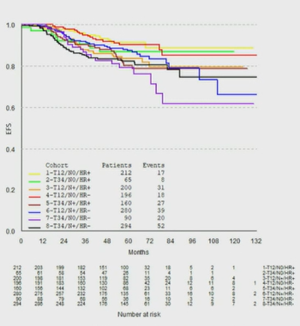
Influence de la présentation initiale sur le risque de rechute malgré la pCR
 |  | N | 5y rate | Hazard Ratio | 95%CI
HR+ pCR- | T1-2/N- (reference) T3-4/N- T1-2/N+ T3-4/N+ | 377 143 448 431 | 84.5% 73.2% 72.1% 60.9% | 0.64 0.60 0.38 | [0.51, 0.81] [0.46, 0.77] [0.28, 0.52]
HR+ pCR+ | T1-2/N- (reference) T3-4/N- T1-2/N+ T3-4/N+ | 212 65 200 160 | 91.4% 87.0% 83.6% 80.4% | 0.84 0.55 0.46 | [0.53, 1.35] [0.33, 0.90] [0.25, 0.85]
HR- pCR- | T1-2/N- (reference) T3-4/N- T1-2/N+ T3-4/N+ | 140 78 251 345 | 66.6% 59.1% 64.9% 45.4% | 0.61 0.76 0.46 | [0.48, 0.78] [0,58, 1.00] [0.33, 0.65]
HR- pCR+ | T1-2/N- (reference) T3-4/N- T1-2/N+ T3-4/N+ | 196 90 280 294 | 90.3% 79.3% 87.5% 82.4% | 0.58 0.87 0.50 | [0.40, 0.84] [0,58, 1.29] [0.30, 0.83]
0.10
0.20
0.30
0.40
0.50
0.80
1.0
1.5
Mackelenbergh M. et al. JCO in press

Slide 79
18th St. Gallen international breast cancer conference 2023
Traitement adjuvant post néoadjuvant si HER2 résiduel négatif
Après un traitement néoadjuvant de type TCHP, si la maladie résiduelle est HER2 négativel en FISH et IHC, le traitement adjuvant doit être
Trastuzumab emtansine
56,92%
CT Anthracycline
15,38%
Les deux
9,23%
Abstention
18,46%

Slide 80
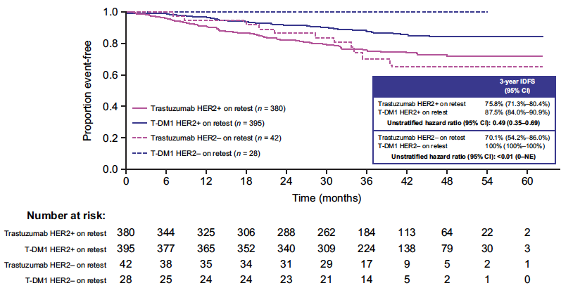
Kaplan–Meier estimates of time to first IDFS event in each treatment arm in Katherine trial according to HER2 status on residual disease.
Loibl S et al. NPJ Breast Cancer. 2022; 8: 106.

Slide 81
18th St. Gallen international breast cancer conference 2023
Traitement adjuvant post néoadjuvant si pCR et cDNA positif
Pour une patiente ayant reçu un traitement néoadjuvant dans un essai clinique comportant du trastuzumab et du pertuzumab et étant en pCR, si une recherche d’ADN tumoral circulant se révèle positif (réalisé dans le cadre de l’étude), celle-ci doit-elle recevoir du TDM1 en situation adjuvante.
Oui
15,38%
69,23%
Abstention
Non
15,38%

Slide 82
HER2+ early breast Cancer: current standards
If ≥ cT2 cN0 or cN+ : neoadjuvant chemotherapy dual HER2 blockade (trastuzumab + pertuzumab)
If cT1 cN0
(or patient preference for primary surgery
surgery
pCR
non-pCR
pT1 pN0
Any pT pN+ or ≥ pT1 N0
Continue trastuzumab for 1 year (add pertuzumab if N+)
T-DM1
(14 cycles)
Adjuvant 12x paclitaxel
+ 1y trastuzumab
Adjuvant polychemotherapy + 1y dual blockade (N+)
(1y trastuzumab if N0)
1year
1y Neratinib
(HR+; high-risk
1y Neratinib
(HR+; high-risk
For all patients (if indicated): Radiotherapy and/or adjuvant endocrine therapy (for HR+)
Bone density measurement: offer adjuvant bisphosphonates (if postmenopausal with ovarian suppression)
Harbeck N. The Breast 2022

